Slide 1
Fiscal Service IRC Meeting
Budget Object Class
November 20, 2024 Update

Slide 2
Budget Object Class Update
FY 2025 GTAS Reporting
Beginning with FY 2025-02 GTAS reporting, only Fund Families with ending balances with Budget Object Class (BOC) 9999 in FY 2024-12 data will be permitted to report beginning and ending BOC 9999 during FY 2025 GTAS reporting.
FY 2025-10 GTAS reporting window: No ending balances with BOC 9999
FY 2026 GTAS reporting windows: No beginning and ending balances with BOC 9999
GTAS edit 999 (Effective FY 2025-02 GTAS reporting window)
GTAS validation 999 (Effective FY 2025-02 GTAS reporting window)
President’s Budget Appendix Volume [TENTATIVE]
FY 2026 Actuals in the FY 2028 President’s Budget: Load GTAS BOC data but don’t apply MAX A-11 DE GTAS-related errors
FY 2027 Actuals in the FY 2029 President’s Budget: Load GTAS BOC data but apply MAX A-11 DE GTAS-related errors
USASPENDING.GOV [TENTATIVE]
FY2026: Broker validation report (Nonfatal - warning)
FY2027: Broker validation report (Fatal)

Slide 3
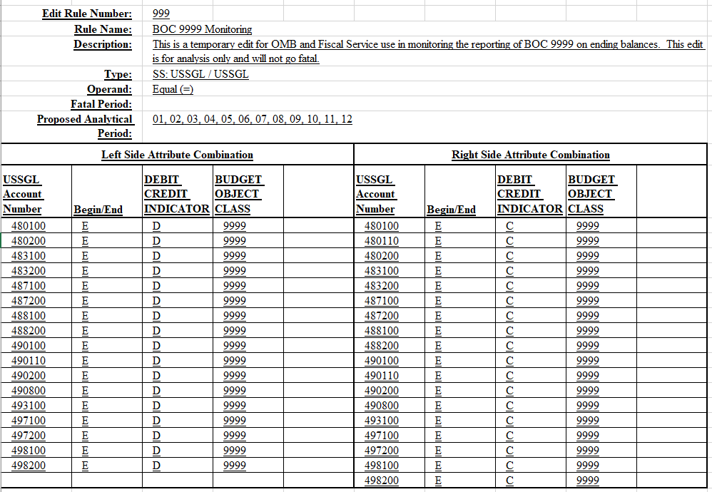
Budget Object Class Update
FY 2025 GTAS Reporting
(Effective FY 2025-02 GTAS reporting window)
GTAS Edit 999

Slide 4
Budget Object Class Update
FY 2025 GTAS Reporting
(Effective FY 2025-02 GTAS reporting window)
GTAS Validation 999

Slide 5
QUESTIONS?

