Slide 1
Treasury Financial Experience (TFX) Brief
Issues Resolution Committee (IRC) Meeting
February 15, 2024
Notes:
Thanks for the time on the agenda today. Before we get into the presentation, I want to say you all have a great group of folks supporting all program areas on TFM information updates and technology moves. Kimberly, Curtis, Laura, and Sheila – they have been uber involved and represented the TFM well. I want to thank the folks/ SMEs for offline conversations and sharing information prior to this meeting.

Slide 2

Agenda
The 5 Ws of TFX…
Who is impacted?
What is happening?
When are we moving?
Where are we going?
Why are we changing?
When?
What?
Where?
Who?
Why?

Slide 3

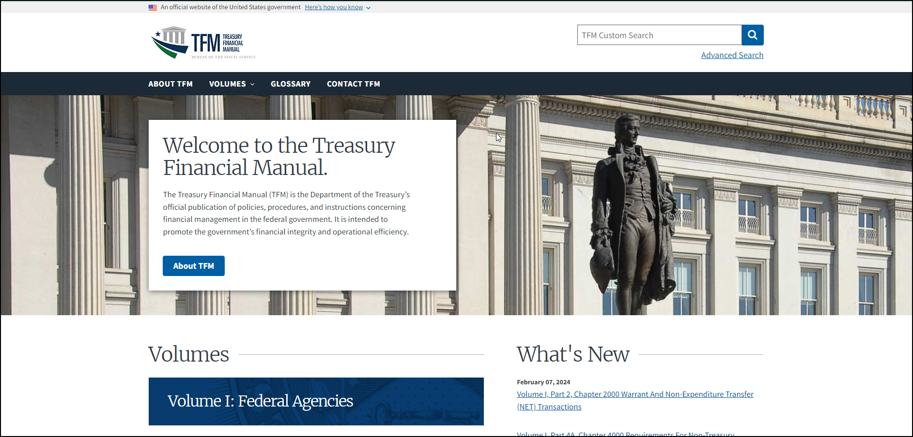
The 5 Ws of TFX – Who?
Who is impacted?
  All users of the TFM site (https://tfm.fiscal.treasury.gov)*
*Site will be turned off 3/31/24

Slide 4

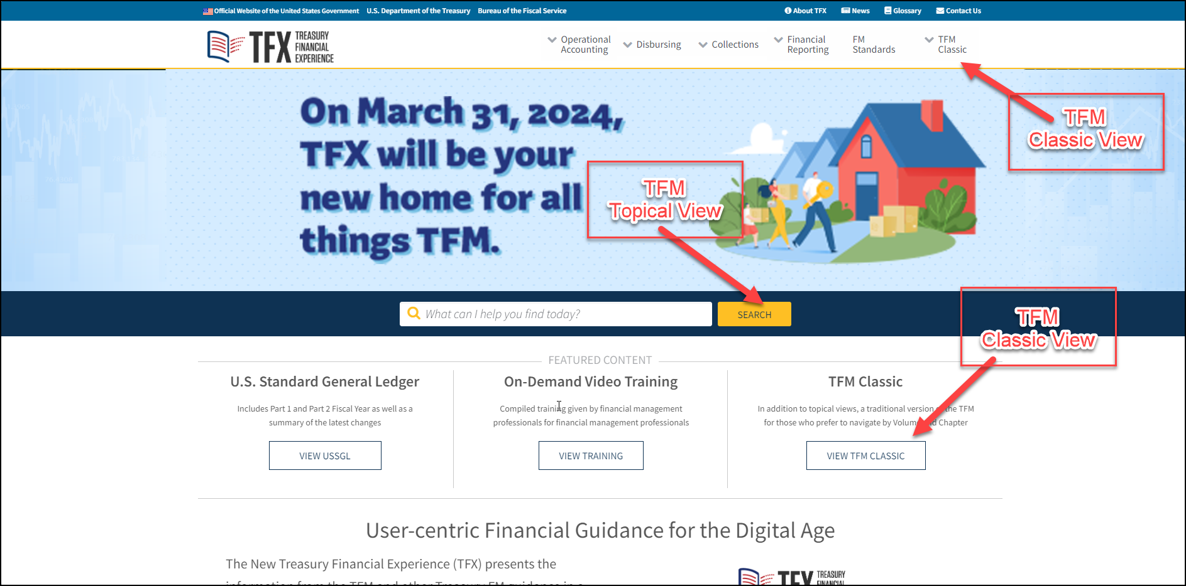
The 5 Ws of TFX – What?
What is happening? 2 TFM Views!
Classic View
Traditional version of the TFM for users who prefer to navigate by Volume and Chapter.
Mirrors current TFM format.
Minor updates/fixes in navigation tabs.
Topical View
Task-based navigation.
Multiple ways to find information.
Robust search with new content management system.

Slide 5



The 5 Ws of TFX – When? Where?
When?
Save the date!
March 31, 2024
Legacy TFM site turned off.
Users will be redirected from TFM to TFX.
Where?
New Location!
Visit the TFX site to tour the 2 TFM view options!
https://tfx.treasury.gov/
Site active now!!!
This Photo by Unknown Author is licensed under CC BY-NC

Slide 6
The 5 Ws of TFX – Why?
Why are we changing?
A look back…
Fiscal Service started the journey to reimagine the Federal Financial Management experience.
  2017: Initial assessment of TFM Vol. 1, conducting 8 Focus Groups with over 350 participants, which identified significant issues in quality, consistency, search, content and external linking.
  2019: TFX was initiated to address these issues and ultimately become a user-centric resource, integrating information across multiple areas to streamline financial management and provide a more personalized experience for those who use it.
Now
TFX will become one-stop-shop for Fiscal Service policy, guidance, and instruction.
Future
Look for more content areas to move into TFX!

