Slide 1
Funds Held Outside Of Treasury
Chad Morris and Margot Kaeser
July 11.2023

Slide 2
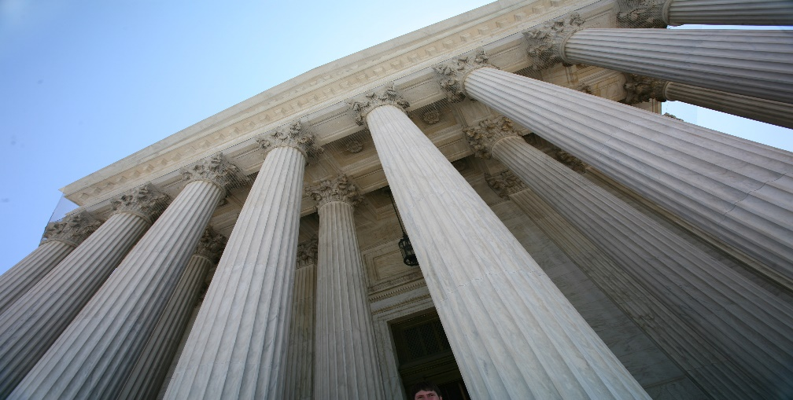
The principal objectives of control of disbursements are to ensure that all disbursements are legal, proper, and correct and that all disbursements are accurately recorded, reported, and reconciled in a timely, efficient manner.

Slide 3
Session Learning Objectives
Learn the definition of Funds Outside of Treasury (FHOT)
Become familiar with statue and policies governing FHOT
Understand when an FHOT may be needed
Learn how to request an FHOT
Learn about properly accounting for FHOT funds
Learn how and when to properly report FHOT

Slide 4

Definitions of FHOT
FHOT, also referred to as Cash held
outside of the U.S. Treasury (CHOT)
and Imprest Fund:
Are funds under the custodial responsibility of federal government entity and/or their employees, officers, or agents that are deposited in accounts at local depository institutions or held in an imprest fund
A fixed-cash or a petty-cash fund in the form of currency or coin that has been advanced to a cashier (Accountable Official)
An account that a Federal entity relies on to pay for small, routine expenses
Is regularly replenished, in order to maintain a fixed balance
May be foreign or domestic

Slide 5

Statue and Policies Governing FHOT
31 U.S.C. § 3302
I TFM 6-3200, Section 3220
“Federal agencies receiving or holding public money from any source are statutorily required to deposit these funds into the U.S. Treasury, unless otherwise authorized by law. Except as otherwise provided by law, the Fiscal Service, as part of its mission, is the agency responsible for collecting, holding, disbursing, and accounting for public money on behalf of most Federal agencies. Consequently, Federal agencies generally may not hold public money outside of the U.S. Treasury and must deposit all public money into an account in the name of the U.S. Treasury….”

Slide 6
Statue and Policies Governing FHOT
31 U.S.C. § 3302
I TFM 4A-3000, Section 30165,
“A federal entity must have legal authority to hold funds outside of Treasury because an imprest fund is a fixed cash or petty cash fund in the form of currency or coin that has been advanced to a cashier as “Funds Held Outside of Treasury.” Imprest funds are an exception to the general rule that federal entities receiving public money from any source are statutorily required to deposit these funds into the U.S.”

Slide 7
Statue and Policies Governing FHOT
First, in rare cases, a federal entity may have statutory authority to hold money without depositing it to the U.S. Treasury.
Second, a federal entity may have implied authority to hold funds outside of Treasury if it has explicit statutory disbursing authority
Third, a federal entity may obtain a delegation of disbursing authority from Treasury’s CDO, if, for reasons of economy and efficiency, the CDO determines such a delegation would be appropriate.”

Slide 8
Statue and Policies Governing FHOT
I TFM 4A-2000, Section 2050.20—Cash Advances
“It is the responsibility of grantor federal entities to monitor the cash management practices of their recipient organizations to ensure that federal cash is not maintained by them in excess of immediate disbursing needs. Federal entities must establish systems and procedures to assure that balances are maintained and commensurate with immediate disbursing needs, excess balances are promptly returned to the Treasury….”

Slide 9
Statue and Policies Governing FHOT
I TFM 4A-3000, Section 30140.20—Operating Account Balance Limitations
“All Accountable Officers must ensure the amount of foreign exchange purchased with U.S. dollars (together with the balance on hand) is commensurate with immediate disbursing requirements, not to exceed a 5 to 7 business day supply, in order to:
Minimize local currency operating bank balances,
Minimize losses due to rate devaluations, and
Avoid premature drawdowns on the TGA.”

Slide 10
Statue and Policies Governing FHOT
31 USC § 3513
I TFM 2-5100, Section 5130.10—Posting Agency Transactions to the USSGL
“Agencies must post account transactions to the USSGL and must prepare an adjusted trial balance at least monthly to verify that debit and credit postings are equal and to validate the data. ”

Slide 11
Statue and Policies Governing FHOT
I TFM 2-3400, Section 3440.30—Federal Account Symbols Requirements
“Entities use Treasury Account Symbols and Business Event Type Codes to report on cash and investments held outside of the U.S. Treasury and changes in non-federal securities. They submit data to the Treasury using the following Business Event Type Codes (BETCs):
Funds Held Outside the Treasury, Credit – FHOTXC; Adjustment to Funds Held Outside the Treasury, Credit – FHOTXCAJ; Funds Held Outside the Treasury, Debit – FHOTXD; Adjustment to Funds Held Outside the Treasury, Debit – FHOTXDAJ are used to report cash held outside of the U.S. Treasury, for both budgetary accounts and deposit funds…..”

Slide 12
Statue and Policies Governing FHOT
I TFM 2-3400, Section 3445—Reconciling Cash and Investments Held Outside of the U.S. Treasury
“ Each entity must do the following:
Reconcile all transactions involving cash and investments held outside of the U.S. Treasury on a periodic basis, but no less frequently than quarterly, and
Develop policies, systems, and operating procedures that ensure cash and investment activity reported on the entity's ATB and Statements of Transactions reported to Treasury, as applicable, reconcile with the entity's accounting records and related statements and reports received from financial institutions.”

Slide 13

When would an FHOT be needed?
For reasons of economy and efficiency
When the Federal entity needs an FHOT to support a specific program
If Fiscal doesn’t have the services available to support entity’s program

Slide 14

Requesting an FHOT
As a preliminary matter, before
a federal entity contemplates
establishing an imprest fund,
the federal entity should first:
Discuss that option with Fiscal Service to determine if an alternative approach might be more suitable

Slide 15
Requesting an FHOT
Submit written request to Linda Chero CDO and AC DDM with a cc to the Division Director of POD. Letter should:
  Outline program FHOT will support and why FHOT is needed to support the program
  Program’s legal status (authority, statue)
  TGA bank* and location for the funds
  How and who will be responsible for the control and reporting
  Include a request, if needed, for a waiver to the 5-7 days of funds on hand, EFT [31 U.S.C. § 3332(f) and 31 CFR § 208.4
Include a letter from the requesting entity’s office of chief counsel that weighs in on legal status of program
*A depositary, a financial institution designated by the Department of the Treasury (Treasury) to hold public money and perform other services per 31 CFR 202.

Slide 16

Properly Accounting and Reporting FHOT
Funds are either IN the TGA or OUTSIDE the TGA
Common scenarios with BETC detail can be found in TFM 2-3400 Appendix 1
Proper reporting is validated by GTAS edits
Reclassifications are often needed to ensure proper reporting

Slide 17



Properly Accounting and Reporting FHOT
TGA
Standard TGA vs FHOT Accounting
FHOT
Decrease
Correct Treatment per TFM Guidance
Increase
Withdrawal of cash reduces Agency’s Bank Balance (FBwT)
FBwT represents each Agency’s available funds within the TGA to pay its obligations. FBwT is the control to ensure the TGA maintains sufficient funds to pay Governmentwide obligations.
Funds are in Agency’s possession (physical cash, local depository account, etc.) Funds are no longer reported in FBwT (TGA Bank balance.)
Incorrect Treatment
Reported Here
Also Reported Here
Entity’s Funds Held Outside of Treasury are still reported in the Entity’s Bank Balance (FBwT) AFTER Cash withdrawal!

Slide 18



Slide 19
Primary Contact DDM Policy
Name: Margot Kaeser
Title: Director, Policy and Oversight Division
Phone: 202-345-3680
Email: margot.kaeser@fiscal.treasury.gov
Primary Contact Fiscal Accounting
Name: Chad Morris
Title: Manager, Cash Accounting Branch
Phone: 304-480-6848
Email: chadwick.morris@fiscal.treasury.gov

