Slide 1
New BETCs for Loan Activity
FY 2020
Missy Williams
May 9, 2019

Slide 2
Schedule of Changes in Cash Balance Vs. the Statements of Changes in Cash Balance
Schedule of Changes in Cash Balance
  For use in the Schedules of the General Fund – Schedule 2
Statements of Changes in Cash Balance
  For use in the U.S Financial Report – Budgetary Statements

Slide 3
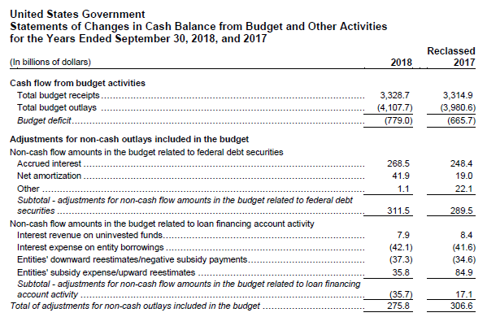
Statements of Changes in Cash Balance from Budget and Other Activities

Slide 4
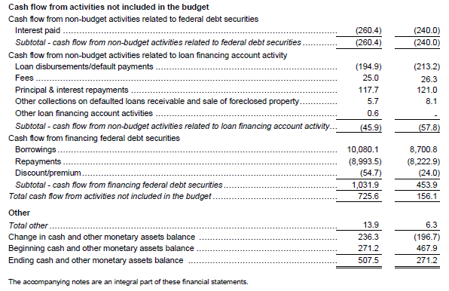
Statements of Changes in Cash Balance from Budget and Other Activities

Slide 5
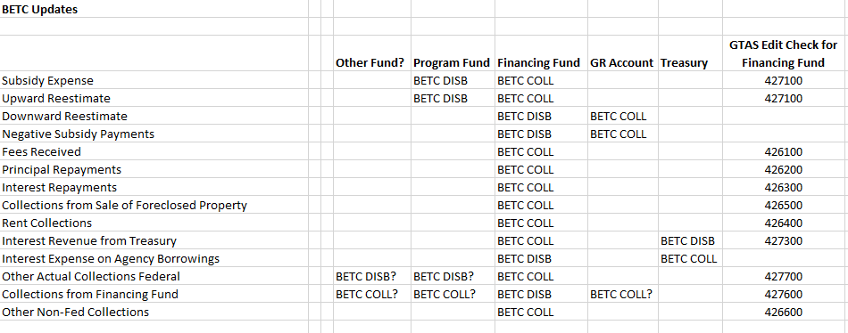
BETC Proposal

Slide 6

Questions?

Slide 7

Primary Contact
Missy D. Williams
Supervisory Accountant
(304) 480-7125
Melissa.Williams@fiscal.treasury.gov
Secondary Contact
D. Lynn Petty
Accountant
(304) 480-7404
Deborah.Petty@fiscal.treasury.gov

