Slide 1
G-Invoicing Update
USSGL Board Meeting
May 2019

Slide 2
Agenda
Background
Stages & Data Flow
G-Invoicing Program Status
Fiscal Service Implementation Strategy
Agency Playbook
Resources

Slide 3

The Future of Financial Management
  “The American citizen expects that:
  1. the government is an efficient steward of its financial resources;
  2. the financial information provided by the government is accurate;
  3. their financial interactions with the government are modern, seamless and secure.”

Slide 4


Supporting the Financial Management Community
We have set goals to improve each of these financial services
Optimize Disbursing
Transform Collections
Strengthen Reporting
Expand Services
Notes:
10 Initiatives from Treasury supporting these.
Strengthen Financial Reporting
Automate inter-agency buy-sell transactions
Reduce buy/sell intragovernmental differences by 90% by 2022. The recent audit found material weaknesses with interagency transfers.
BENEFIT: A reliable system for recording interagency transactions in pursuit of a clean audit opinion.
Implement single government financial statement with risk-based audits
Make federal financial data more accessible

Slide 5
Buy/Sell Transactions
In today’s Buy/Sell Transaction process, there are several challenges including:
  Lack of an automated broker
  Lack of communication and concurrence between partners
  Lack of governmentwide data standards
  Lack of central repository
Result in $21 Billion in IGT Buy/Sell elimination differences in FY18
Notes:
21 Billion Pre-JV Number
Governmentwide IGT Buy/Sell Facts – Fiscal Year 2018
IGT Buy/Sell transactions identified in GTAS totaled approximately $780 Billion
92 Federal Program Agencies actively engage in IGT Buy/Sell activity, leveraging approximately 700 Agency Location Codes (ALCs)

Slide 6
G-Invoicing is our Solution!
TFM Bulletin No. 2018-10 “Implementing G-Invoicing” established a mandate date of June 30, 2021
G-Invoicing will serve as:
  An agreement broker
  A data exchange utility (FIDS); and
  A conduit for sharing data and exchanging information on Buy/Sell IGT activity.
Notes:
Government Invoicing (G-Invoicing) is the long-term sustainable solution to improve the quality of Intragovernmental Transactions (IGT) - Buy/Sell data in support of more accurate financial management by Federal Trading Partners
G-Invoicing will implement a Federal Intragovernmental Data Standard (FIDS) and a platform through which Federal Trading Partners will broker IGT Buy/Sell transactions
A transparent IGT Buy/Sell data repository will support reconciliation, reduce adjustments, and drive proper Governmentwide IGT Buy/Sell eliminations

Slide 7
G-Invoicing Transaction Stages

Slide 8
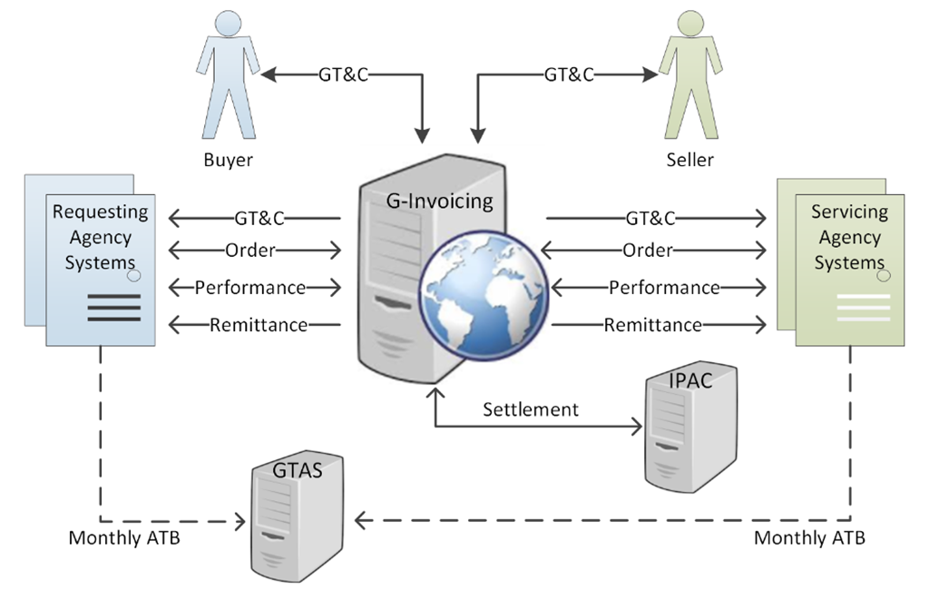
G-Invoicing Data Flow

Slide 9
System Development
Release 2.1 – General Terms & Conditions (Deployed in March 2018)
Release 2.2 – Orders (Deployed in March 2019)
Release 2.3 – Performance and Enhancements (August 2019)
  Release 2.X – Settlement & Enhancements
    (Incremental releases through June 2020)

Slide 10
Interface Specifications (FIDS)
Collaborating with the Financial Management Standards Committee (FMSC) and Intragovernmental Transactions Working Group (ITWG)
Specification Releases
  General Terms & Conditions (GT&C)
    June 2017
  Orders
      May 2018
    Performance Transaction
      February 2019
    Performance Update for Remittance
      April 2019

Slide 11
G-Invoicing Roadmap
Release 2.Y..2/Z
Release 2.2.1/ Release 2.3
Business goal: Exchange of performance data to improve accrual accounting
Business and Technical goal: Enhance usability of GT&C processing ; eliminate security vulnerabilities
Release 2.2
Performance User Interface
-Advance
-FOB Source
-FOB Destination
Performance Application Interface
-Advance
-FOB Source
-FOB Destination
G-Invoicing GT&C UI Enhancements
-Replacement of xign framework
Business Goal: Brokering Orders to improve accounting
Reporting
-Order Detail Report
-Performance Detail Report
Order User Interface
-Create, approve, reject, close
-Order attachments
Release 2.X
Business Goal: Improve traceability of chargebacks
Order Application Interface
-Create, approve, reject, close
-Order attachments
Business Goal: Reduce chargebacks and improve efficiency of settlement
G-Invoicing Initiated Adjustments
-Performance driven
Transaction Settlement
-Advance
Transaction Settlement
-FOB Source
-FOB Destination
Reporting
-Settlement Report Details
Now Next Later

Slide 12
Upcoming Important Dates
Agency Implementation Plans
  June 28, 2019
Performance Transaction Exchange Functionality
  August 2019
Performance Validations to Initiate G-Invoicing Settlement
  Incremental releases through June 2020
G-Invoicing Mandate
  June 30, 2021
Early Adoption is Encouraged!

Slide 13
The Engagement and Onboarding Team
FASO EOS (Engagement)
FRB AIT (Systems)
ITRB (Business)
  Relationship Management Lead
    Conduct outreach to industry and FPAs.
    Initiate direct engagement with FPAs.
    Manage leadership engagement.
    Review and publish implementation monitoring.
    Escalate and ensure resolution of issues.
  Onboarding Lead
  Guide implementation of GT&Cs, Orders, and Performance.
  Facilitate Change Management.
  Coordinate integration between FM systems and G-Invoicing.
  Train Administrators and Users.
  Report on FPA onboarding status.
  Fiscal Service Experts on IGT Processes
    Support implementation activities.
    Resolve issues and ensure alignment with policy.
Notes:
With G-Invoicing, we are taking a three-point approach to engagement and onboarding. Each agency will have a team of three, one expert from each of the focus areas key to implementation: Outreach, Systems, and Business.
Engagement
Fiscal Accounting Support and Outreach, Engagement and Onboarding Staff (EOS)
Relationship Management Lead
Conduct outreach to industry and FPAs.
Initiate direct engagement with FPAs.
Manage leadership engagement.
Review and publish implementation monitoring.
Escalate and ensure resolution of issues.
Systems
FRB Agency Implementation Team (AIT)
Onboarding Lead
Guide implementation of GT&Cs, Orders, and Performance.
Facilitate Change Management.
Coordinate integration between FM systems and G-Invoicing.
Train Administrators and Users.
Report on FPA onboarding status.
Business
Intragovernmental Reconciliation Branch (ITRB) Accountants
Fiscal Service Experts on IGT Processes
Support implementation activities.
Resolve issues and ensure alignment with policy.

Slide 14
13 FPAs own 90%+ of Buy/Sell Transactions
Rank | % GTAS Value FY 18 | High-Priority Targets | % IPAC Volume FY 18 | IPAC
1 | 74% | DoD | 58% | 1
2 | 4% | GSA | 11% | 2
3 | 3% | DHS | 3% | 4
4 | 3% | HHS | 2% | 8
5 | 2% | DOS | 0.70% | 16
6 | 2% | VA | 3% | 7
7 | 2% | DOJ | 5% | 3
8 | 1% | DOI | 3% | 5
9 | 1% | DOC | 1% | 14
11 | 1% | DOE | 3% | 6
12 | 1% | USDA | 1% | 10
14 | 1% | Treasury | 1% | 9
19 | < 1% | USAID | 0.30% | 21
High-priority targets were identified by overlaying the:
FPAs with the highest % GTAS dollar value (including their top three trading partners) with the
FPAs with the greatest % IPAC volume.
Notes:
High-priority targets were identified by overlaying the 1)FPAs with the highest % GTAS dollar value (including their top 3 trading partners) with the 2)FPAs with the greatest % IPAC volume.
As we set out to identify the High-Priority targets, we started by ranking FPAs by their volume of IPAC Buy/Sell transactions looking primarily at the top 10.
IPAC Buy/Sell transactions are generally high volume, but with a low dollar amount. So next, we overlaid the dollar value of GTAS activity, which 1)is reported specifically by FPAs and 2)is the best indicator of Buy/Sell dollar value.
Identifying the top FPAs in these two categories yielded a target list of 13 FPAs, together responsible for more than 90% of Buy/Sell transactions.
For G-Invoicing, this is clearly the sweet spot and our starting point for active engagement.

Slide 15

Steps to Implementation and Onboarding
Onboarding Touchpoints
Demos
Training
Focus Group Meetings
FPA Work Sessions
Organize a Cross-Functional Team
Review Elements Against FIDS
Inventory Data
Design Plans for GT&C, Orders, Performance
Perform Change Management
Update Systems
Test Systems
Process Transactions
Implementation Playbook Checklist
Notes:
Standardized implementation of G-Invoicing presents us with challenges:
FPAs have adapted IGT Buy/Sell procedures to their unique missions.
The implementation of G-Invoicing represents both a business process and systems change management effort.
G-Invoicing impacts multiple functions across each FPA -- Financial Management, Contracting, Procurement, Logistics, and Systems Support.
While no two FPAs are identical, we have created an eight-step Playbook Checklist in order to standardize the general approach to implementation and provide high-level guidance to FPAs:
Organize A Cross-Functional Team: Create an agency G-Invoicing work group including areas currently supporting the IGT Buy/Sell business line. The work group should include representatives from critical financial, business process, and financial system(s);
Review Elements Against FIDS: Review the Federal Intragovernmental Data Standards. Compare the FIDS to your current business processes and your system requirements to gauge alignment. Participate in Intragovernmental Transactions Working Group (ITWG);
Inventory Data: Perform an inventory of agency data and associated business processes and systems;
Design Plans for GT&C, Orders, Performance: Plan changes to systems and business processes to capture IGT Buy/Sell related data associated with General Terms and Conditions, Orders, and Transaction Performance; (insert plan here)
Perform Change Management: Implement changes to existing operating procedures to ensure alignment with required G-Invoicing process flows. Ensure that data processed and exchanged with FPA Trading Partners is in a format consistent with the FIDS System Mapping and Validation Rules (i.e., G-Invoicing data standards and interface specifications).
Update Your Systems: Implement Enterprise Resource Planning (ERP) system changes as necessary to ensure G-Invoicing data exchange requirements are supported. Leverage ITWG and Financial Management Standards Committee (FMSC) working groups to ensure best practices are followed;
Test Systems: Establish a G-Invoicing test account to test system changes as necessary to ensure exchanges are accurate and reliable; and
Process Transactions: Initiate IGT Buy/Sell Transactions with FPA Trading Partners and ensure G-Invoicing required process steps are executed. Update and refine process.
Our Onboarding team uses regular touchpoints – Focus Group Meetings, FPA Work Sessions, Demos, Training, and more – to guide agencies through this process.

Slide 16
Resources and Outreach
Broad Outreach
  Agency Work Groups (ITWG)
  Quarterly Newsletter
  GFMC Conference
  Webinars
Resources available here include:
  Program Guide
  Office Hours
  Data Standards
Notes:
G-Invoicing Website:
https://www.fiscal.treasury.gov/g-invoice/

Slide 17
Contact Information
Chris Beck
Manager, Bureau of the Fiscal Service
(304) 480-7122
Christopher.beck@fiscal.treasury.gov
Intragovernmental Transactions Working Group IGT@fiscal.treasury.gov
https://www.fiscal.treasury.gov/g-invoice/

