Slide 1
GTAS 2.11 –
Manual Adjustment by USSGL
USSGL Board Meeting May 10, 2018

Slide 2
What’s Changed?
Manual Adjustments done at the USSGL level as opposed to only supplying the line item information.
Added Line Numbers
Added Text Box for justification.

Slide 3
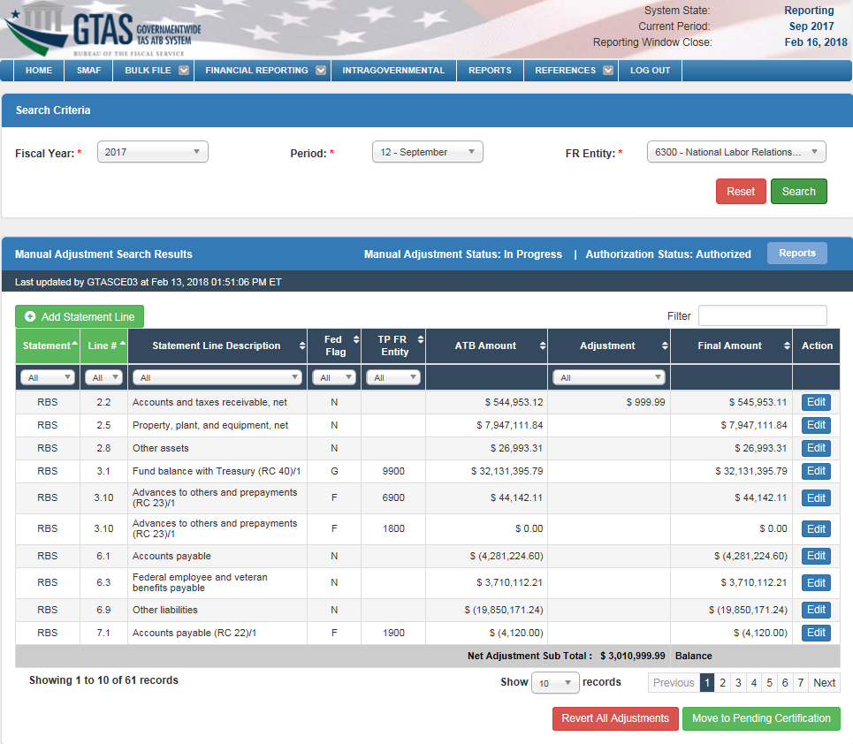
Manual Adjustments – On Entry (Preparer)

Slide 4
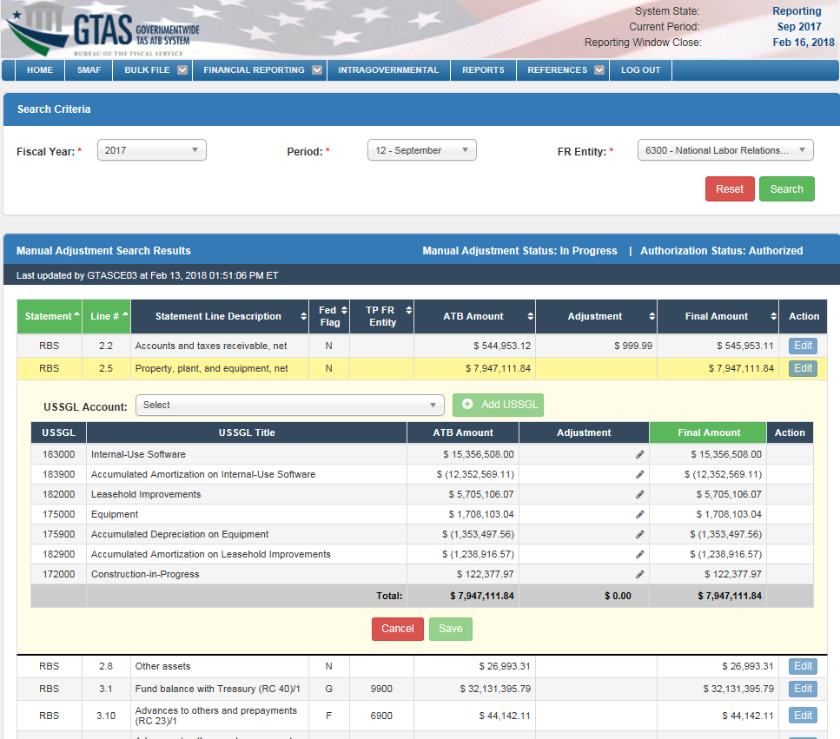
Manual Adjustments – Edit (Preparer)
Example of Line with the USSGL Breakout for adjustment

Slide 5
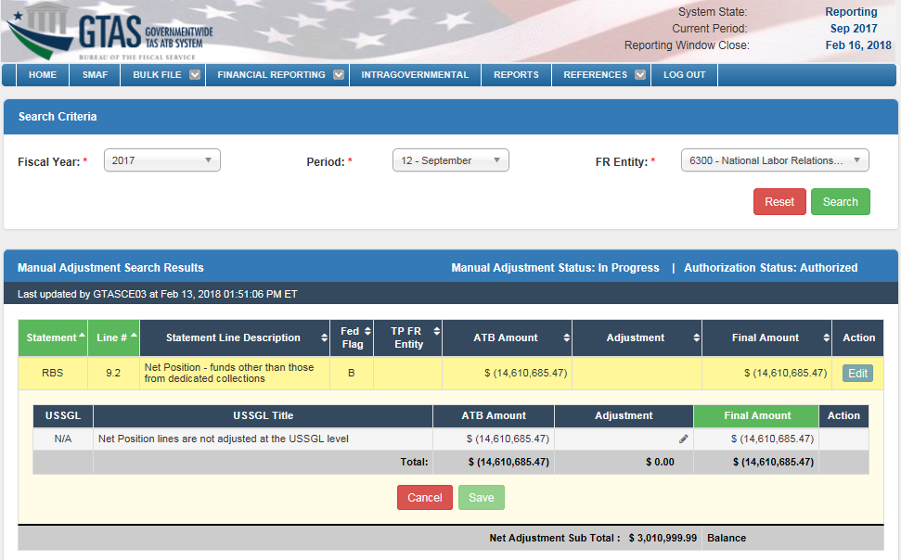
Manual Adjustments – Edit (Preparer)
Example of Line 9.2 (Net Position) & no USSGL Breakout

Slide 6
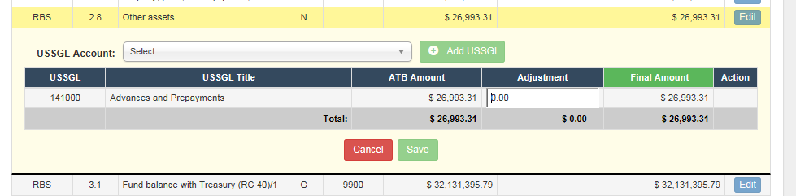
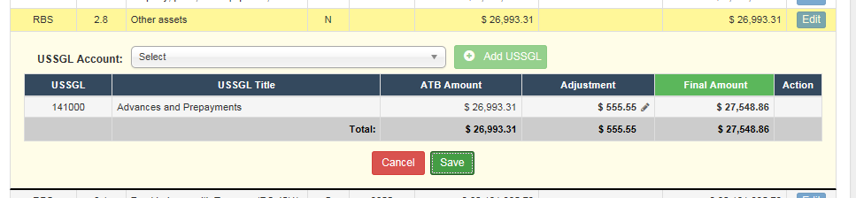
Manual Adjustments – Edit (Preparer)
Clicking in the Adjustment Field allows it to be changed:
Clicking ‘enter’ or tabbing off the field saves the adjustment and the save button is enabled:

Slide 7
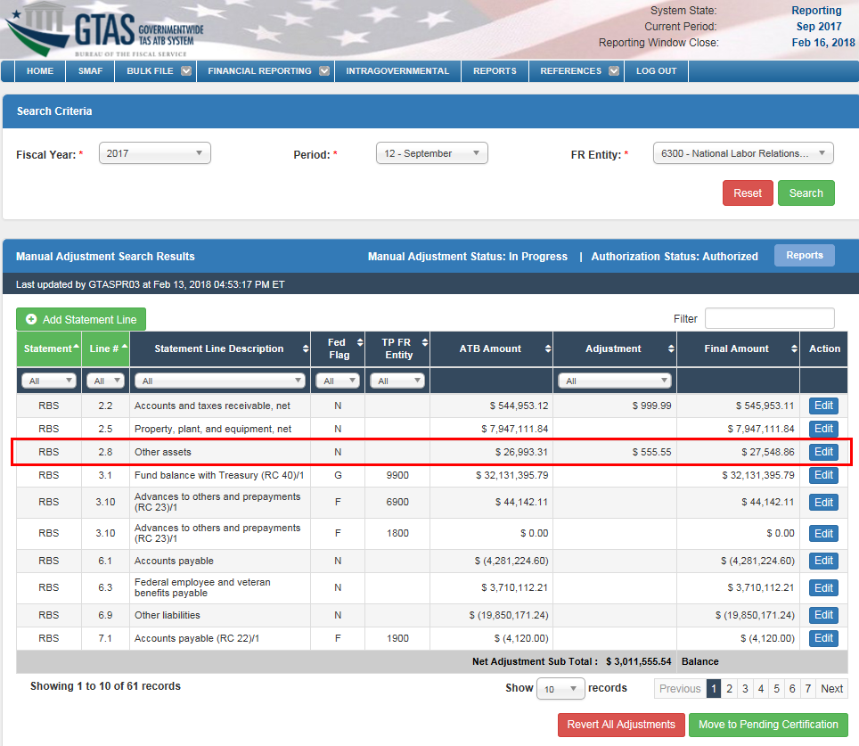
Manual Adjustments – Edit (Preparer)
Adjustment is applied after clicking save in the prior examples

Slide 8
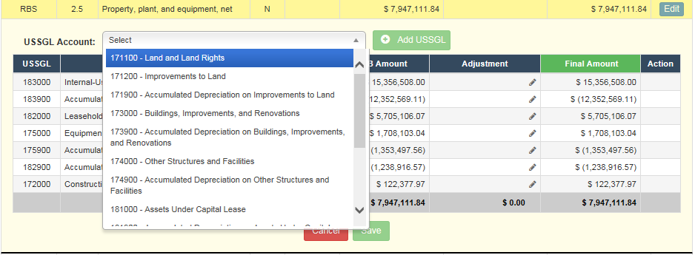
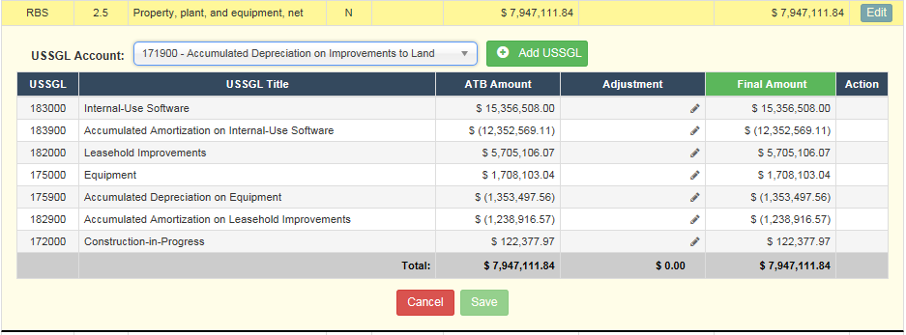
Manual Adjustments – Edit (Preparer)
Available USSGL Accounts for the line available via the Reclassified Balance Sheet’s Configuration
Selecting a USSGL Account enables the ‘Add USSGL’ button

Slide 9
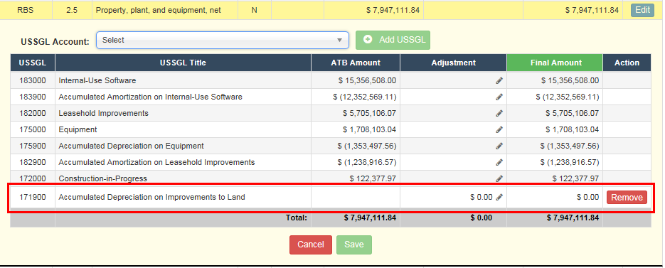
Manual Adjustments – Edit (Preparer)
Adding a USSGL Account is placed at the bottom of the table. The Preparer can apply the Adjustment amount on this line; if added by mistake, the Preparer can click the ‘remove’ button.

Slide 10
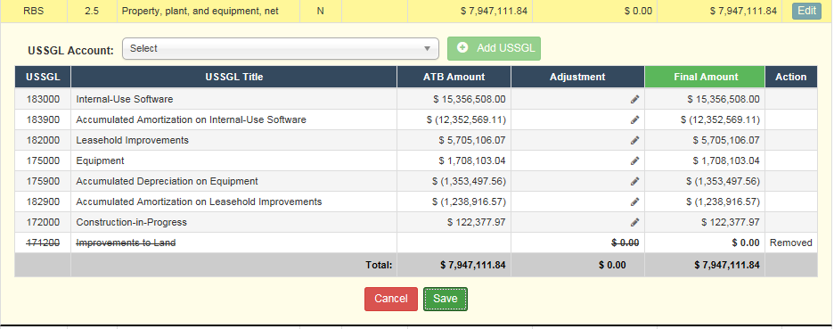
Manual Adjustments – Edit (Preparer)
Example of a ‘removed’ USSGL Account; after clicking ‘save’, the USSGL Account will be permanently removed.

