Slide 1
FR Modernization
Jaime M. Saling
May 10, 2018

Slide 2

GTAS and GFRS Update
FY 2018 Reporting
  No changes to closing package process
FY 2019 Reporting
DoD
Compilation
IGT

Slide 3
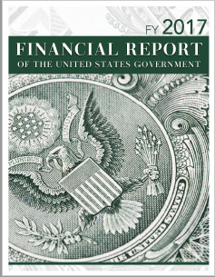
Current State
Governmentwide Treasury Account Symbol Adjusted Trial Balance System (GTAS)
Governmentwide Financial Reporting System (GFRS)
Disclaimer
Modules 6-8 Manual Entry
Notes:
Explain that the focus is just the preparation of the FR
Focus on all entities do GTAS reporting but for the FR significant entities still have to do all modules in GFRS.
Point out the use of significant entities GTAS data throughout the fiscal year and at year end for analysis and closing audit recommendations.

Slide 4
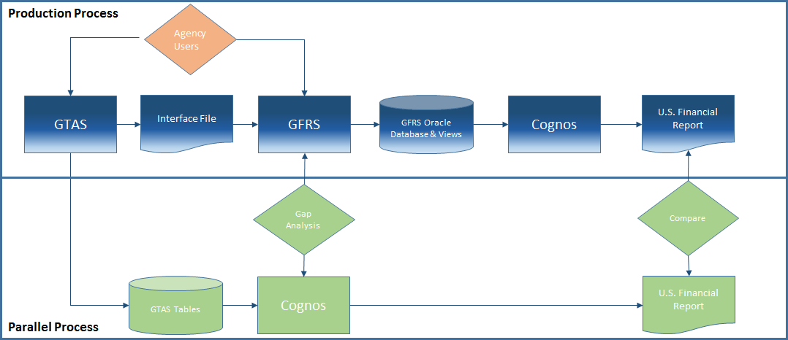
System Environment for FR Compilation - FY 2018
Phase 1 Objectives:
  Gap analysis between GFRS/Cognos
  Compare production FR to FR produced from the parallel process
  Identify back office changes needed to support the new process (agency certifications and closing package procedures)

Slide 5
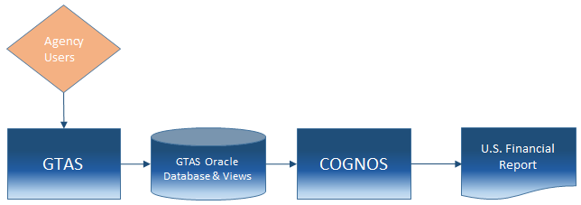
System Environment for FR Compilation - FY 2019
Phase 2 Objectives:
  Position Treasury to decommission GFRS
  Single point of entry for agency users
  Modernize certifications for Closing Package approvers
  Continue to support traceability between agency audited financial statements and governmentwide statements
Notes:
Final Notes (only cover if needed):
The 1S setup is better for external agency access, making it a good fit for SS.
1S does not have a component that is equivalent to CDM, making it a bad fit for FR publication. CDM is a client installed application, making it a bad fit for SS.
The crosswalking aspect of creating agency financial statements can be done in either system.
Conceptually, it makes sense to do the data analysis work to crosswalk agency financial statements from GTAS as a conduit to the FR in Cognos as a proof of concept. If decisions are made that send us down the path of needing external agency access in Cognos, it would make sense to take another look at 1S. At that point, we will have plenty of 1S experience from the SS project. Additionally, it would not be a huge stretch to re-create the data hierarchies in 1S from the Cognos proof of concept work.

Slide 6

What Does this Mean to You?
FY 2018
No Changes to the Closing Package Process
FY 2019
No more GFRS!
GTAS populated financial statement lines plus a significant portion of the footnotes
Provide “non-crosswalkable” footnotes, other data, RSI, RSSI to Treasury in a new way
Changes to the Closing Package audit (Full Financial Audit, AUPs, or Examination)

Slide 7

Jaime M. Saling
Department of the Treasury
Bureau of the Fiscal Service
(304) 480-5129
Jaime.Saling@fiscal.treasury.gov

