Slide 1
Financial Report of the United States Government (FR) Modernization
USSGL IRC Meeting March 1, 2018

Slide 2
Agenda
  FR Consolidation History/Progress
  FR Modernization Mission
  System Environment for FR Compilation - Current
  System Environment for FR Compilation – Future
  Decrease in Agency Reporting Burden
  Impact on USSGL TFM Supplement

Slide 3
FR Consolidation History/Progress
Enhancement to GTAS in FY 2016
  GFRS Modules 1-4 are now captured in GTAS
  The reclassified statement crosswalks are now used to populate line information for agencies to review (formerly GFRS module 3)
  Previously agencies were able to manually enter these amounts in GFRS. GTAS now populates these lines from agencies bulk files (using USSGL Crosswalks). Agencies use manual adjustments column to adjust line items at FR entity level.

Slide 4
FR Modernization Mission
Improve the quality and integrity of data used to produce the Financial Report of the U.S. Government (FR), while decreasing agency reporting burden to Treasury in the process

Slide 5
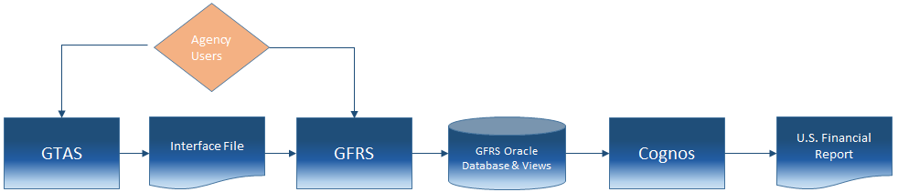
System Environment for FR Compilation - Current
Notes:
  Multiple agency touchpoints (GTAS/GFRS)
  Three systems (GTAS/GFRS/Cognos)

Slide 6
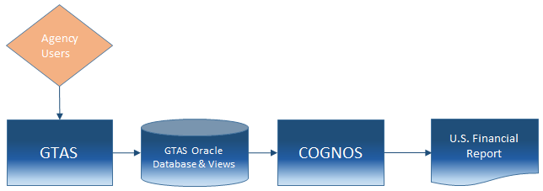
System Environment for FR Compilation - Future
Objectives:
  Decommission GFRS
  Single point of entry for agency users
  Modernize certifications for Closing Package approvers
  Continue to support traceability between agency audited financial statements and governmentwide statements
Notes:
Final Notes (only cover if needed):
The 1S setup is better for external agency access, making it a good fit for SS.
1S does not have a component that is equivalent to CDM, making it a bad fit for FR publication. CDM is a client installed application, making it a bad fit for SS.
The crosswalking aspect of creating agency financial statements can be done in either system.
Conceptually, it makes sense to do the data analysis work to crosswalk agency financial statements from GTAS as a conduit to the FR in Cognos as a proof of concept. If decisions are made that send us down the path of needing external agency access in Cognos, it would make sense to take another look at 1S. At that point, we will have plenty of 1S experience from the SS project. Additionally, it would not be a huge stretch to re-create the data hierarchies in 1S from the Cognos proof of concept work.

Slide 7
Decreasing Agency Reporting Burden
Elimination of redundant data entry across multiple systems
Remove need to log into multiple systems
Potential reduction in manual processes
Decrease complexity

Slide 8
USSGL TFM Supplement & the FR
USSGL TFM Supplement already plays major role in FR preparation:
  Establishes and Maintains Chart of Accounts
  Ensures accurate data is flowing to FR via Validations/Edits
  Section VI Reclassified Crosswalk used to produce various FR Financial Statements

Slide 9
USSGL TFM Supplement Impact
Fiscal Service as part of FR Modernization is looking at the note data captured in Module 6
  Agencies already provide much of this information in their bulk file
  Crosswalks are being developed to capture this data
  Fiscal Service has not determined where this guidance will be contained, but USSGL TFM Supplement is one possible solution

Slide 10
Inventory Note Crosswalk Example
Reference Handout

Slide 11
Next Steps
Fiscal Service has established a project team
Project team will review system and data requirements (including developing Note Crosswalks)
GFRS parallel with replacement process in FY 2018
Replace GFRS in FY 2019

