Slide 1
Appendix I of TFM 2-4700
Jaime M. Saling
February 9, 2017

Slide 2
Objective
Reduce redundant guidance published by the Department of the Treasury to eliminate the risk of publishing inconsistent guidance to the agencies.

Slide 3
TFM 2-4700 : Appendix I
TFM 2-4700 : Appendix I
  Reclassified Balance Sheet
  Line Item Descriptions
  Reclassified Statement of Net Cost
  Line Item Descriptions
  Reclassified Statement of Operations and Changes in Net Position
  Line Item Descriptions

Slide 4
Reclassified Financial Statements

Slide 5
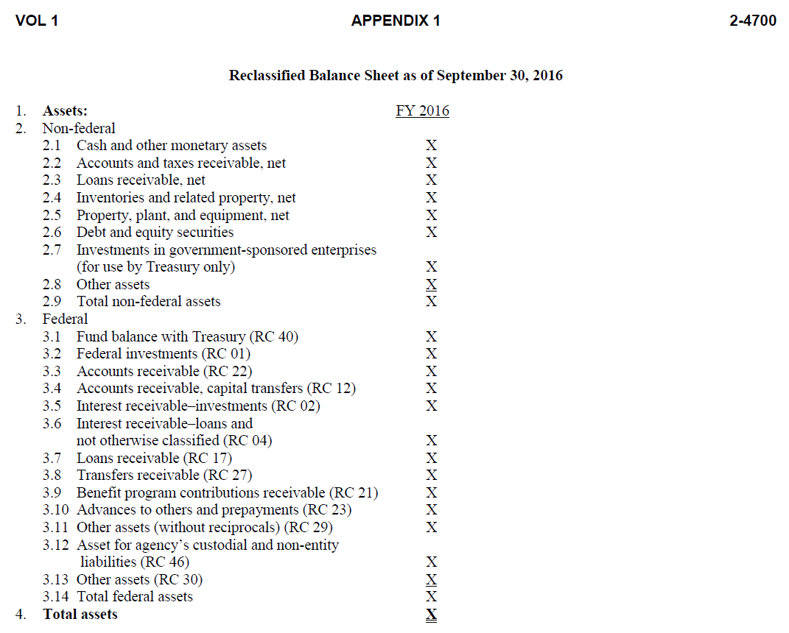
TFM 2-4700 : Appendix I

Slide 6
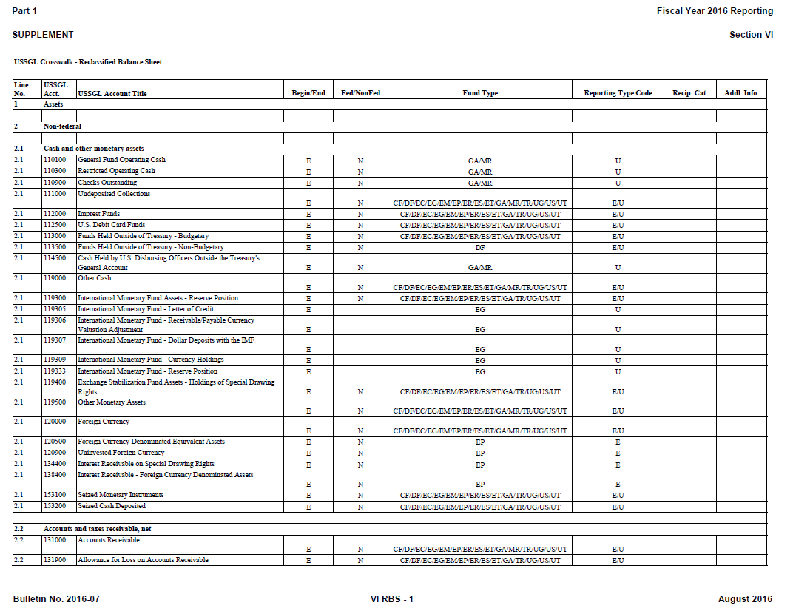
USSGL Section IV: Crosswalks to Reclassified Statements

Slide 7
Line Item Descriptions

Slide 8
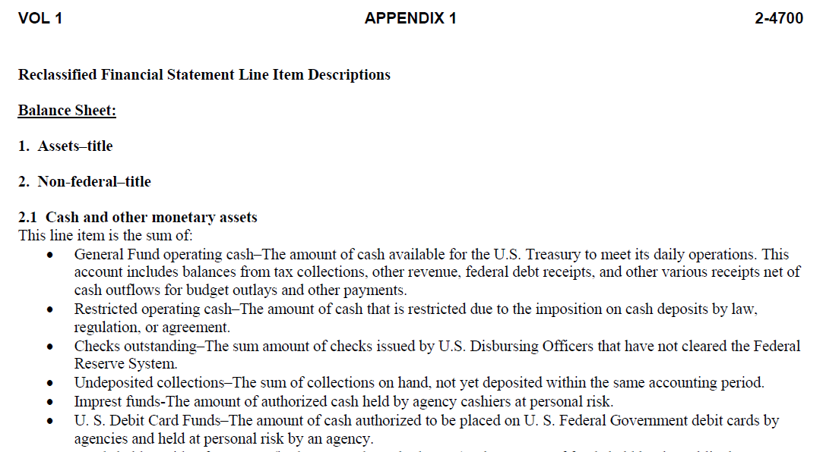
TFM 2-4700 : Appendix I

Slide 9

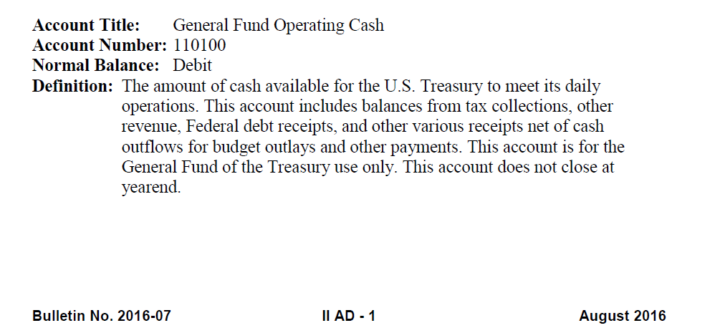
USSGL Section II: Accounts and Definitions

Slide 10
Fiscal Year 2017 Proposed Changes
TFM 2-4700 : Appendix I
USSGL Supplement
Reclassified Financial Statements
Section VI: Crosswalks to Reclassified Statements
Line Item Descriptions
Section II: Accounts and Definitions

Slide 11
Next Steps
Send agency concerns, questions, suggestions, etc. to Financial.Reports@fiscal.treasury.gov by March 16
Financial Report Questions:
Financial.Reports@fiscal.treasury.gov

Slide 12

Jaime M. Saling
Department of the Treasury
Bureau of the Fiscal Service
(304) 480-5129
Jaime.Saling@fiscal.treasury.gov

