Slide 1
Government Invoicing
(G-Invoicing)
USSGL Board Meeting
May 12, 2016

Slide 2
Agenda
  IGT Material Weakness
  IGT by the Numbers
  G-Invoicing Update
  Final Thoughts
  Questions

Slide 3
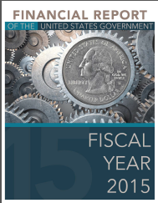


IGT Material Weakness
History of Material Weakness for the U.S. Government
As it has for each of the past 19 fiscal years, the U.S. Government Accountability Office (GAO) issued a disclaimer of opinion on the FY 2015 Financial Report of the U.S. Government. In its report, GAO cited the government's difficulty to "adequately account for and reconcile intra-governmental activity and balances between federal entities" as a material weakness and a major impediment to expressing an opinion.
Three Primary Impediments
DoD
Compilation
IGT
Disclaimer

Slide 4
IGT Material Weakness
The Issue
The Simplicity of the IGT Issue:
“If two federal entities engaged in an intragovernmental transaction do not both record the same intragovernmental transaction in the same year and for the same amount, the intragovernmental transactions will not be in agreement, resulting in errors in the consolidated financial statements.”
- FY 2015 U.S. GOVERNMENT ACCOUNTABILITY OFFICE INDEPENDENT AUDITOR’S REPORT

Slide 5
Buy/Sell by the Numbers
Total IGT Differences– FY2015 (Year End)

Slide 6
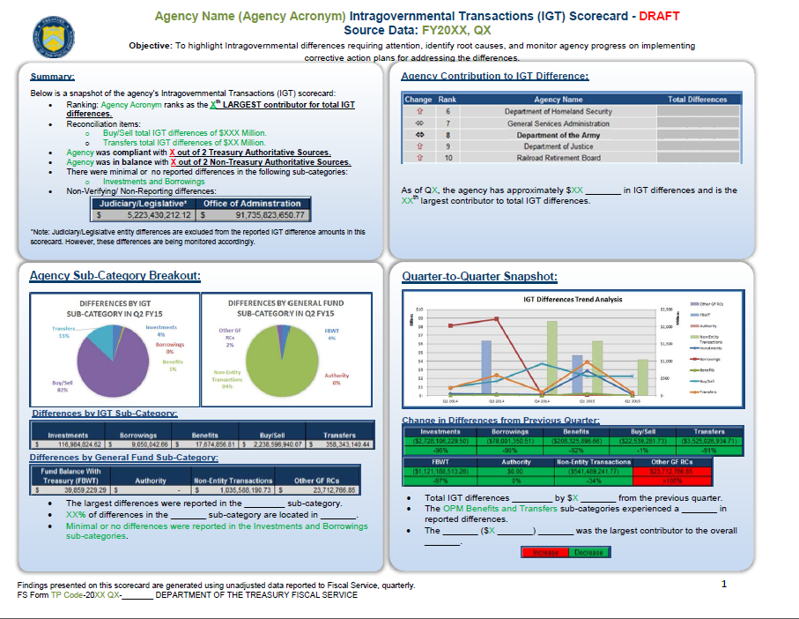
Buy/Sell by the Numbers
Agency IGT Scorecard and Metrics

Slide 7
Buy/Sell Fundamentals
Accurate reporting of buy/sell balances and proper elimination of buy/sell activity depends largely upon….
COMMUNICATION

Slide 8
G-Invoicing -- Fact Sheet
G-Invoicing is an application which supports the brokering of Intragovernmental Buy/Sell Transactions by Federal Trading Partners
The application will enable users to manage the processing and approval of General Terms and Conditions, Orders and Invoices
Data collected through workflow activities will initiate IPAC transactions to perform fund settlement

Slide 9
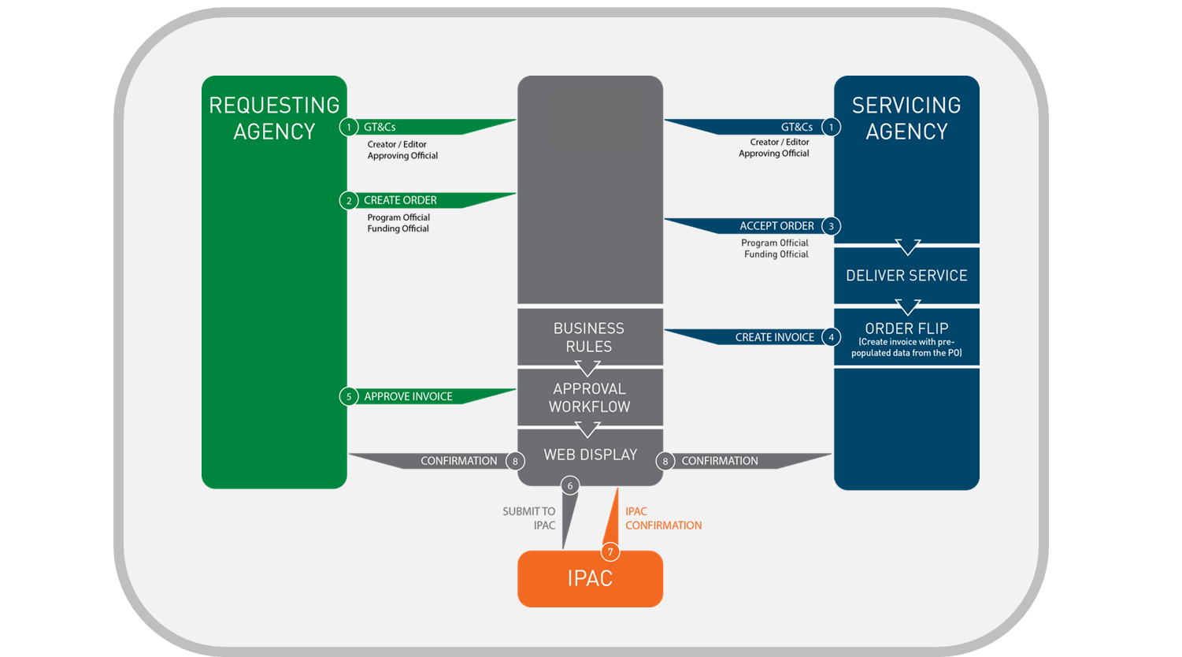

IGT Information Flow

Slide 10
Current System Offerings
IPP-IGT - Invoice Processing Platform - Intragovernmental Transactions Buy/Sell Module
  Originally implemented in support of DoD
  Being re-branded in September 2016 as G-Invoicing
IPAC - Intra-Governmental Payment and Collection System
  Settlement mechanism for Buy/Sell transactions
  Will operate in conjunction with G-Invoicing to accomplishment the movement of funds

Slide 11
System Development Activities
G-Invoicing 1.0 – September 2016
  Separates IPP (E-Invoicing) and IPP-IGT (Buy/Sell)
  Rebrands the application to G-Invoicing
  Only active Users and GT&C data will be migrated / converted as part of the 1.0 Release
G-Invoicing 2.0 – Summer 2017
  Focus will be on enhancements to begin positioning G-Invoicing for a Governmentwide rollout
  Continue to address change requests relating to security and enhanced permissions logic to control/limit user data access
Subsequent Releases
  Align enhancements by core functions (GT&C, Order, Invoice)
  Address requirements to facilitate Agency onboarding and implementation of data standards

Slide 12
Impact to the IGT Buy/Sell Difference
How will the G-Invoicing Application help to resolve the material weakness relating to IGT Buy/Sell in the Financial Report of the United States Government?
What G-Invoicing will be:
  Agreement Broker
  Workflow Enabler
  Data Exchange Platform
What G-Invoicing will not be:
  Not an Accounting System
  Not a Procurement System
  Not a replacement for talking to your trading partner

Slide 13
IGT Policy Standardization
Inter-Agency Agreement (IAA)
FMS Form 7600A – General Terms and Conditions (GT&C)
FMS Form 7600B – Order
  Joint effort by OMB, FSIO / FMLoB, Fiscal Service, CFO Council, and many participating Agencies
  Implemented in the IPP-IGT system
Minimum Accounting Data Elements (MADES)
2013 Treasury Financial Manual (TFM)
  Chapter 4700, Appendix 10

Slide 14
Intragovernmental Data Standard
The Intragovernmental Transactions Working Group (ITWG)
  Re-instituted under Fiscal Service’s leadership in August 2015 with the mission to define Federal IGT Buy/Sell Data Standards for Agreements, Orders and Invoices
Upcoming Publication Milestones
  Fiscal Service Data Registry Updates – May 2016
    GT&C, Order, Invoice
  TFM Bulletin – May 2016
    New Data Standards and rescission of MADES
  TFM Chapter 4700, Appendix 10 Publication – May 2017

Slide 15
Key Stakeholder Engagement
Department of Defense
Partnering with DoD’s Business Integration Office (BIO)
  Directly supporting DoD Piloting of the current IPP-IGT System along with continued training and onboarding of users
  Ongoing sessions with BIO and their development team to discuss system enhancement requests and data standard alignment
  Monthly participation in the Collaborative Agency Working Group chaired by BIO to discuss progress on G-Invoicing development and the data standards
Intragovernmental Data Standards Working Group Participants
Commercial Vendors
  Establishing a working group to bring together key partners from ORACLE, SAP, and CGI Momentum to share results of our data standardization effort and discuss G-Invoicing rollout strategies
BEP | CIA | DOC | DoD | DOJ | DOL | Education
Energy | EPA | FBI | GPO | GSA | HHS | NASA
NRC | NSA | ODNI | OPM | Treasury | USDA | VA

Slide 16
2016 Outreach Activities
American Society of Military Comptrollers Professional Development Institute (ASMC PDI) – June
  Partnering with DoD at local ASMC PDI sessions as needed
DoD Reimbursable Work Orders (RWO) Day – November
AGA Professional Development Conference – July
Government Financial Management Conference – August
ITWG – Agency Level Focus Group Sessions – Ongoing

Slide 17
Contact Information
For IGT Program Management and Agency Outreach Support
Matt Conrad
Manager, Intragovernmental Branch
Bureau of the Fiscal Service – Fiscal Accounting
304-480-1004
matt.conrad@fiscal.treasury.gov
Keith Jarboe
IGT Agency Outreach – Project Support Division
Bureau of the Fiscal Service – Fiscal Accounting
202-874-7818
keith.jarboe@fiscal.treasury.gov
For Intragovernmental Transactions Working Group Information
  IGT@fiscal.treasury.gov
  Alex Abshire (alexander.abshire@fiscal.treasury.gov)
  Wesley Vincent (wesley.vincent@fiscal.treasury.gov)
  https://community.max.gov/x/OYJ1Ng

Slide 18
Final Thoughts
Remediating the Material Weakness
Ultimate goal is to eliminate IGT differences at the governmentwide level for the Consolidated FR.
“Resolving the intragovernmental transactions problem remains a difficult challenge and will require a strong and sustained commitment by federal entities to timely resolve differences with their trading partners”
- FY 2015 U.S. GOVERNMENT ACCOUNTABILITY OFFICE INDEPENDENT AUDITOR’S REPORT

Slide 19

Questions

