Slide 1
Improving the Financial Report of the U.S. Government - 2016 Plans with GTAS and GFRS
Luke Sheppard
May 12, 2016

Slide 2
Objective
Improve the quality and integrity of data used to produce the Financial Report of the U.S. Government (FR), while decreasing agency reporting burden to Treasury in the process.

Slide 3
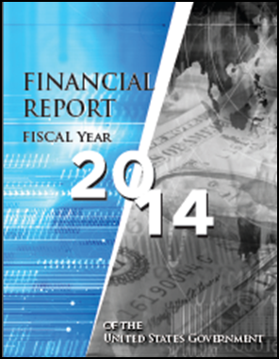
2015 (and PY) Reporting State
Other Entities
Governmentwide Treasury Account Symbol Adjusted Trial Balance System (GTAS)
Governmentwide Financial Reporting System (GFRS)
Extensive Manual Entry
All Entities
Significant Entities
Notes:
Explain that the focus is just the preparation of the FR
Focus on all entities do GTAS reporting but for the FR significant entities still have to do all modules in GFRS.
Point out the use of significant entities GTAS data throughout the fiscal year and at year end for analysis and closing audit recommendations.

Slide 4
Planned Future Reporting Changes
 | 2015 |  | 2016 |  | TBD
Reporting Entity | Reclassified Statements and Trading Partner Data Source | Notes and Other Data Source | Reclassified Statements and Trading Partner Data Source | Notes and Other Data Source | Reclassified Statements and Trading Partner Data Source | Notes and Other Data Source
Significant Entity | Manual Entry | Manual Entry | GTAS* | Manual Entry | GTAS | GTAS/ Manual Entry
Other Entity | GTAS | Manual Entry | GTAS | Manual Entry | GTAS | GTAS/ Manual Entry
*Notes:
Capability provided to agencies to adjust GFRS at financial statement line level (to be phased out over some period of time)
Will still require agency CFO and IG approval

Slide 5
Future State
Governmentwide Financial Reporting System (GFRS)
Limited Manual Entry
Governmentwide Treasury Account Symbol Adjusted Trial Balance System (GTAS)
Notes:
Explain that the focus is just the preparation of the FR
Focus on all entities do GTAS reporting but for the FR significant entities still have to do all modules in GFRS.
Point out the use of significant entities GTAS data throughout the fiscal year and at year end for analysis and closing audit recommendations.

Slide 6
Benefits
Improved data quality/integrity
    Data at lower level detail (TAS and USSGL rather than Financial Statement line level)
    Data has already been exposed to extensive edits and validations
    Automated vs manual population
  Reduced agency reporting burden (leveraging what agencies already provide to Treasury in GTAS)
  Streamlined financial reporting guidance
  More efficient and effective FR compilation process for Treasury
    One data source for detailed analysis
    Likely reduction of a large percentage of ‘on the top adjustments’ (journal vouchers)

Slide 7
2016 Year-End Reporting - Details
Agencies will submit year-end GTAS Bulk File ATB data as normal in GTAS
Certified TAS from GTAS will be summarized at the FR Line level, using the USSGL Reclassified Statement cross-walks
Intra-departmental eliminations will occur in GTAS before the data is sent to GFRS (i.e, only agency consolidated amounts will be sent to GFRS).
Only Certified TAS will be included in the interface to GFRS.
The 2016 Draft TFM is now available (https://community.max.gov/pages/viewpage.action?pageId=839418232), detailing these changes.

Slide 8
2016 Year-End Reporting - Details
All agency CFO and OIG personnel (and associated contractors) need to request access to OMB Max to view the TFM draft. Please contact OMB Max support at 202-395-6860 or email maxsupport@omb.eop.gov
Once access is granted, everyone will then need to contact the GTAS team to be added to a group to view the TFM draft page. GTAS.Team@fiscal.treasury.gov

Slide 9
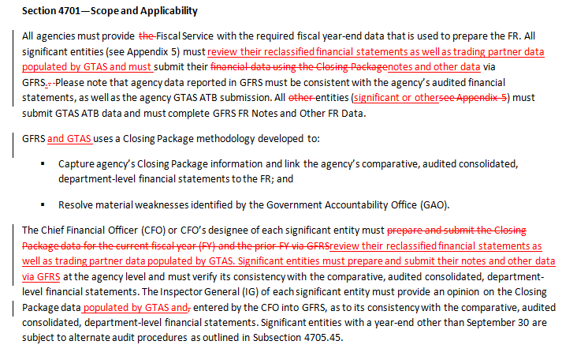
2016 Year-End Reporting - Details
The 2016 Draft TFM has updated guidance (see snapshot below):

Slide 10
2016 Year-End Reporting - Details
Once the Agencies have certified in GTAS, they will need to run a new report, coming in GTAS 2.8 release (scheduled for August), called “Reconciliation Report.”
This report will have the calculated Closing Package Line amounts, post intra-departmental eliminations
Agencies are then required to tie these Reports to their audited General Purpose Financial Reports (GPFR).

Slide 11
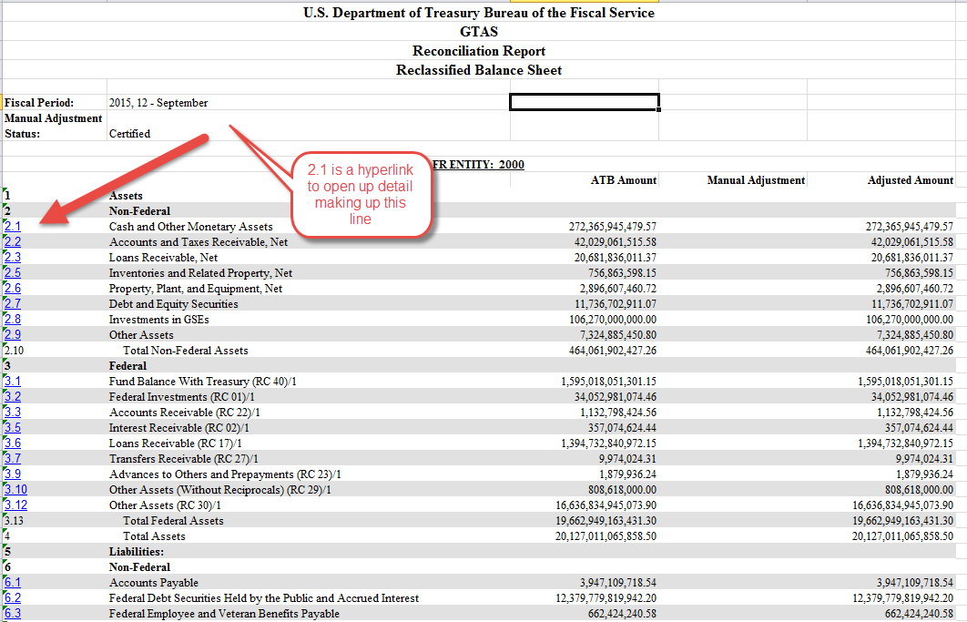
2016 Year-End Reporting - Details

Slide 12
2016 Year-End Reporting - Details
Resolution of Report differences:
Differences due to incorrect GTAS submissions (e.g., incorrect USSGL and/or attribute), are to be resolved via a resubmit of GTAS bulk files to correct the issue.
For differences that cannot be resolved via a GTAS Bulk File resubmission, manual adjustments will be needed in GTAS. The Agency must request this in OMB Max Collect Exercise (https://collect.max.gov/?id=6093&type=Exercise).
There will be a new folder in GTAS titled “Manual Adjustments” for agency entry.

Slide 13
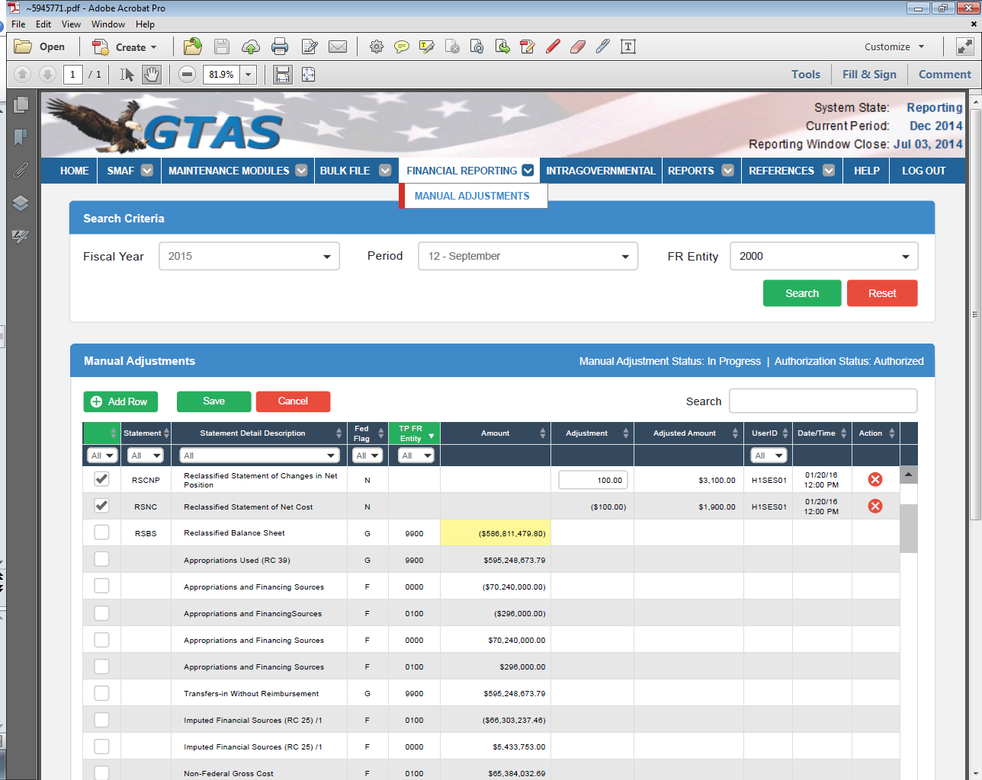
2016 Year-End Reporting - Details

Slide 14
2016 Year-End Reporting - Details
Agencies will be required to obtain approval from Fiscal Service to do a Manual Adjustment in GTAS.
Each Manual Adjustment will require an Explanation.
All Manual Adjustments must be certified by the Agency before it can be included in the Interface to GFRS (similar to how only certified TAS are sent to GFRS).
Agencies will be required to reconcile their Closing Package data, based on their GTAS ATB upload and Manual Adjustments, if any, to their GPFRs.

Slide 15
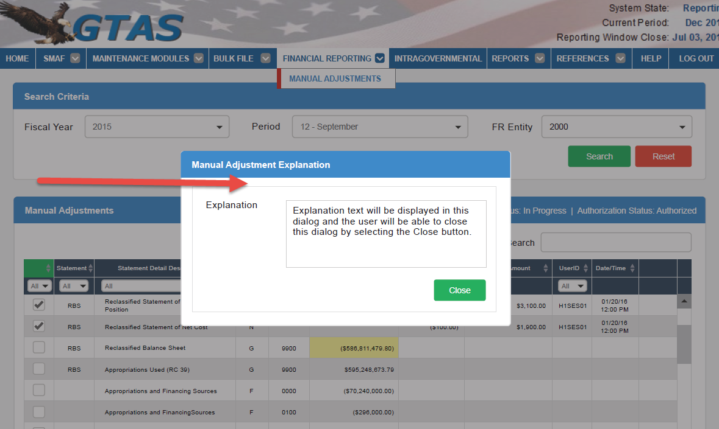
2016 Year-End Reporting - Details

Slide 16
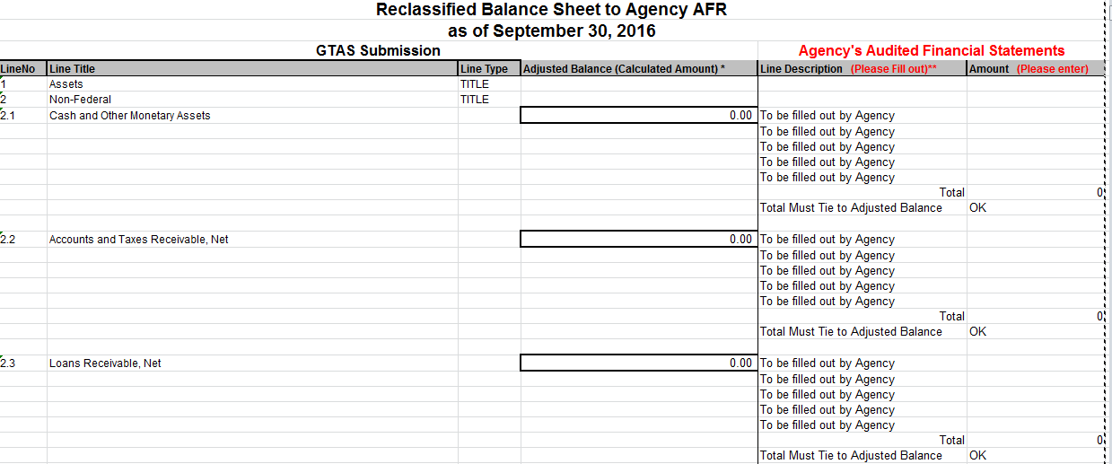
2016 Year-End Reporting - Details
Fiscal Service has devised an Excel template for Agencies to tie their GPFR to GTAS data.

Slide 17
2016 Year-End Reporting - Details
Once the TAS ATB data and Manual Adjustments are certified in GTAS and the Agencies have reconciled to their GPFR:
Agencies must then go into GFRS to complete their Notes and Other Data sections (Modules 6 and 7).
After Modules 6 and 7 are complete, Agency Preparers, CFOs and IGs must then complete Module 8 and submit the audit package.

Slide 18
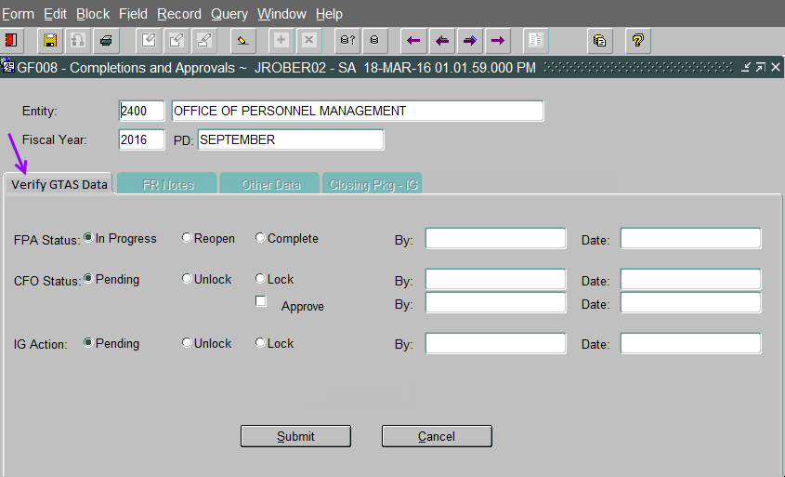
2016 Year-End Reporting - Details
Module 8 (Completions and Approvals) in GFRS has been revised accordingly.

Slide 19
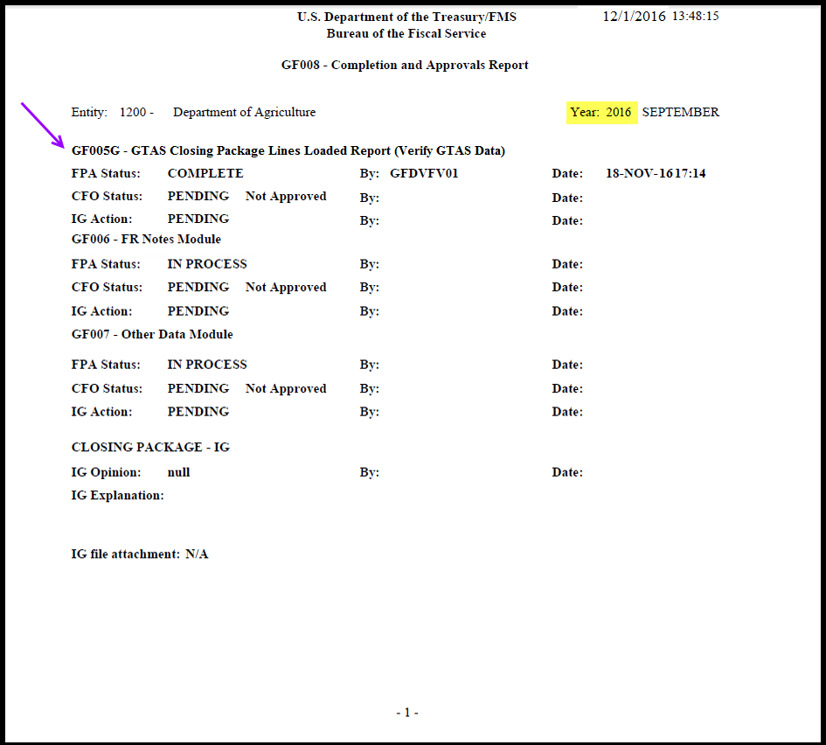
2016 Year-End Reporting - Details

Slide 20
Changes Impacting OIGs (and IPAs)
More emphasis on GTAS this year.
Changes are underway to federal audit guidance (OMB Bulletin 15-02) to ensure changes are consistent with I TFM 2-4700.
OIG and related IPA personnel, will require access to GTAS to review the Reconciliation Report and any other detail reports.

Slide 21
Changes Impacting OIGs (and IPAs)
OIG/IPA personnel should sign up for GTAS access as an “Executive” role. The Executive role is view only, and will allow users to run reports and view the Manual Adjustments.
To sign up for GTAS you can go to this web site: https://fiscal.treasury.gov/gtas/getting-started.html
For any questions on how to sign up, please contact the Treasury Support Center.
1-877-440-9476 or email GWA@stls.frb.org

Slide 22
Questions?

Slide 23
Oscar Castro
Department of the Treasury-
Bureau of the Fiscal Service
(202) 480-5104
Luke.Sheppard@fiscal.treasury.gov
Jaime Saling
Department of the Treasury
Bureau of the Fiscal Service
(304) 480-5129
Jaime.Saling@fiscal.treasury.gov

Slide 24
Luke Sheppard
Department of the Treasury
Bureau of the Fiscal Service
(304) 480-5104
Luke.Sheppard@fiscal.treasury.gov
Michael Conley
Department of the Treasury
Bureau of the Fiscal Service
(304) 480-5521
Michael.Conley@fiscal.treasury.gov

