Slide 1

DATA Act Implementation Update
Briefing for the USSGL‐IRC
May 14, 2015
1

Slide 2


DATA Act Goals
Expand the Federal Funding Accountability and Transparency Act of 2006 by disclosing direct federal agency expenditures and linking federal contract, loan, and grant spending information to programs of federal agencies to enable taxpayers and policy makers to track federal spending more effectively.
Provide consistent, reliable, and searchable government‐wide spending data that is displayed accurately for taxpayers and policy makers on the USASpending.gov website.
Analyze federal spending data to proactively prevent waste, fraud, abuse, and improper payments.
Simplify reporting for entities receiving federal funds by streamlining reporting requirements and reducing compliance costs while improving transparency.
Improve the quality of data submitted to USASpending.gov by holding federal agencies accountable for the completeness and accuracy of the data submitted.
PRE-DECISIONAL/FOR DISCUSSION PURPOSES ONLY
2

Slide 3
Vision & Agency Opportunity
Vision
Provide reliable, timely, secure, and consumable financial management data for the purpose of promoting transparency, facilitating better decision making, and improving operational efficiency.
Better Data, Better Decision, Better Government
GOALS
❑ Capture and make available financial management data to enable the data consumers to follow the complete life cycle of Federal spending ‐‐ from appropriations to the disbursements of grants, contracts, and administrative spending
❑ Standardized information exchanges – definitions and format – to enable timely access to discoverable and reusable detail transaction level data
❑ Design and refine processes and systems to streamline reporting requirements and reduce compliance costs while improving transparency
3

Slide 4




DATA Act in Context of Spending Life Cycle
Receipts/ Financing
Appropriation
 | 360 Spending Life Cycle
 | DATA Act
 | FFATA (USAspending.gov)
Payment
Apportionment
Obligation
Allotment (Allocation)
Award
Commitment
4

Slide 5
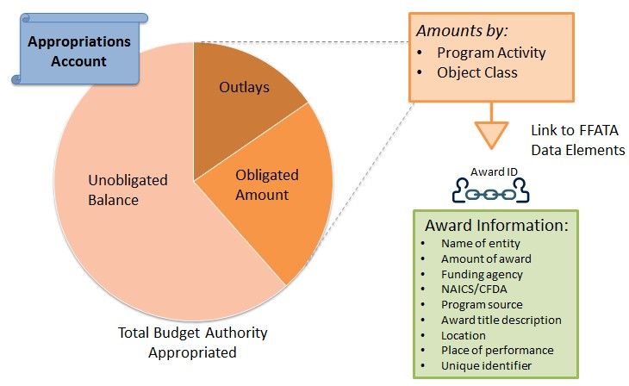
DATA Act Requirements
FFATA Sec. 3 “Full disclosure of federal funds”
Source: Agency financial systems
Source: Agency management systems/FPDS
5

Slide 6
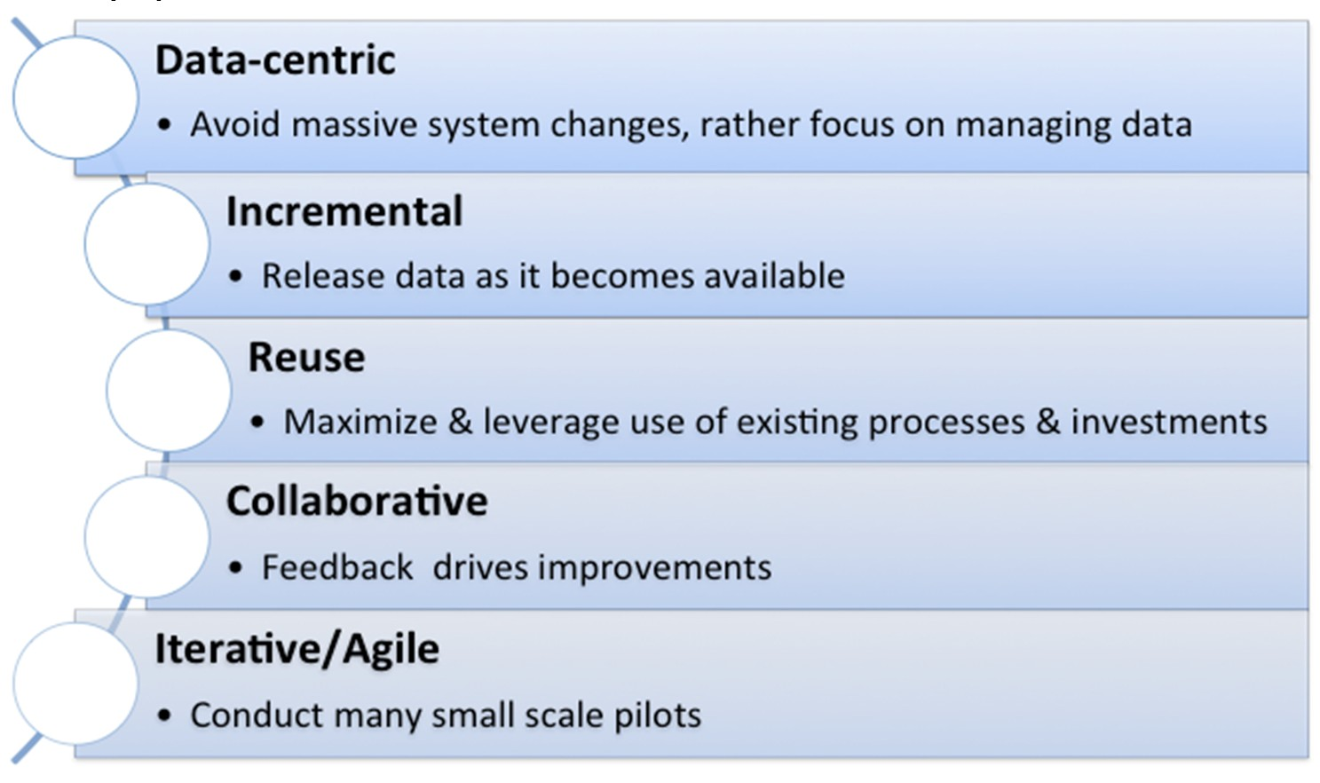
Implementation Approach
We will work to both provide the necessary linkages between financial events as well as enable users to query data across the government.
Implementation is not about adding an additional field to a system to answer a particular question; it is about working towards being able to access information to answer any question.

Slide 7
Agency 8‐Step Plan
Steps for Agencies | Timeline
1) Organize team Create an agency DATA Act work group including impacted communities (e.g., CIO, Budget, Accounting, etc.) and Identify Senior Accountability Officer (SAO) | By spring 2015
2) Review elements Review list of 83 DATA Act elements and participate in data definitions standardization | By spring 2015
3) Inventory data Perform inventory of Agency data and associated business processes | February 2015 – August 2015
4) Design & strategize a) Plan changes (e.g., adding Award IDs to financial systems) to systems and business processes to capture data that are complete multi‐level (e.g., summary and award detail) fully‐linked data b) Prepare cost estimates for FY 2017 budget projections | March 2015 – August 2015
5) Execute broker Implement broker (includes mapping of data from agency schema to the DATA Act schema; and the validation) iteratively | September 2015 – February 2016
6) Test broker implementation Test broker outputs to ensure data are valid iteratively | September 2015 – February 2016
7) Update systems Implement other system changes iteratively (e.g., establish linkages between program and financial data, capture any new data) | September 2015 – February 2017
8) Submit data Update and refine process (repeat 5‐7 as needed) | March 2016 – May 9, 2017

Slide 8
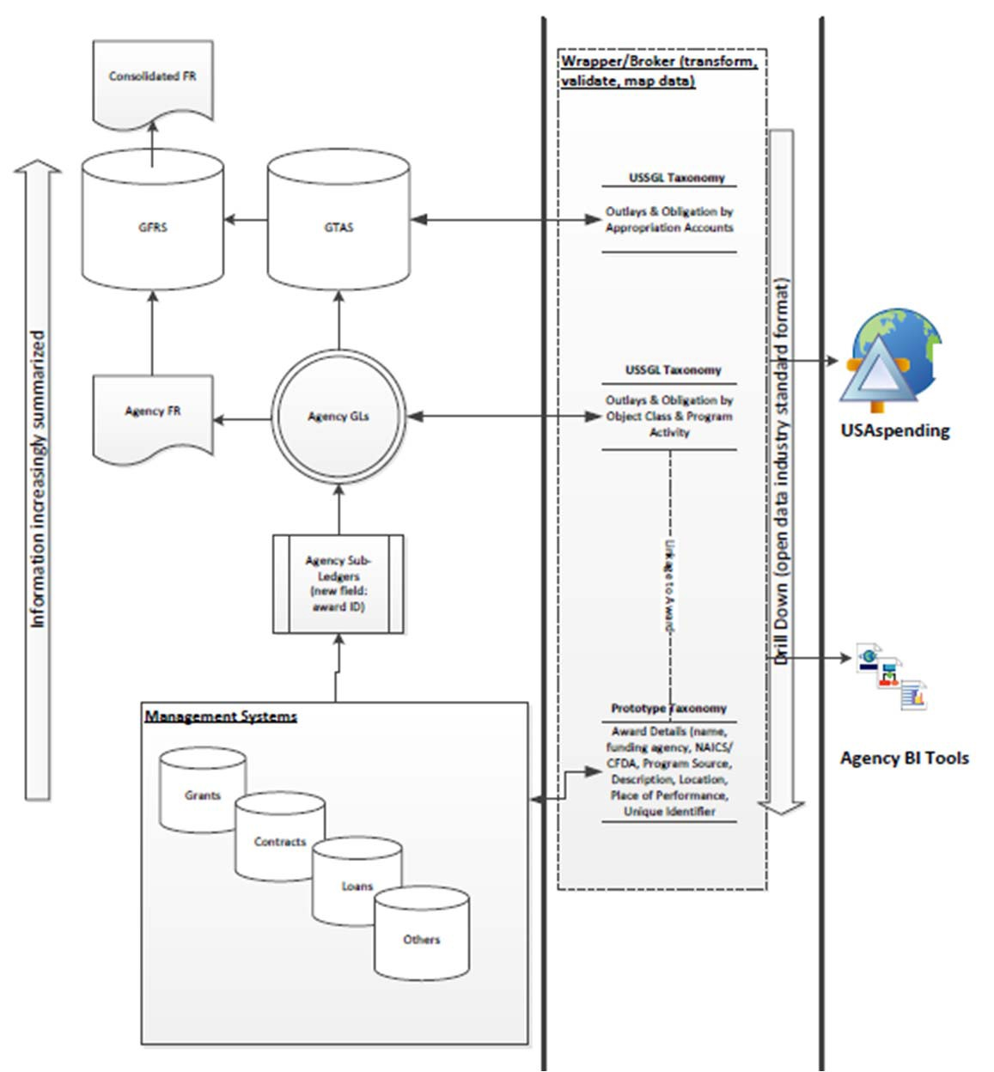

High Level Data Flows
Broker:
Aggregates Agency data from internal/external systems (e.g SAM, FPDS, Oracle, etc).
USAspending:
Re‐validates agency data
Publishes/visualizes data
Agency BI Tools:
Assists Agency managers with analyzing, transforming, and reporting data

Slide 9
Activities
May 8th Guidance Package
  OMB Policy guidance
  Data element definitions
  Data exchange standard (“Schema”)
  Agency Implementation Playbook Summary
Next steps
  Finalize standards for all data elements
  Complete pilots
  Work with Agencies on implementation

Slide 10
Resources
Primary Contact
DATA Act Program Office
Email: DATAPMO@fiscal.treasury.gov
Websites
MAX page
https://community.max.gov/x/OYIkDw
GitHub
https://fedspendingtransparency.github.io/

Slide 11
Appendix
12

Slide 12
Governance and Implementation Structure
Executive Steering Committee – OMB and Treasury
Inter‐Agency Advisory Committee – OMB, Treasury, OSTP, GSA and Representatives from: CFOC, BOAC, ACE, COFAR, CAOC, CIOC, PIC
Design and Implement
Lead
Support Consult
OMB
Treasury
Treasury
Senior Accountable Officials from Federal Agencies
Treasury
OMB
OMB
Treasury
12

Slide 13
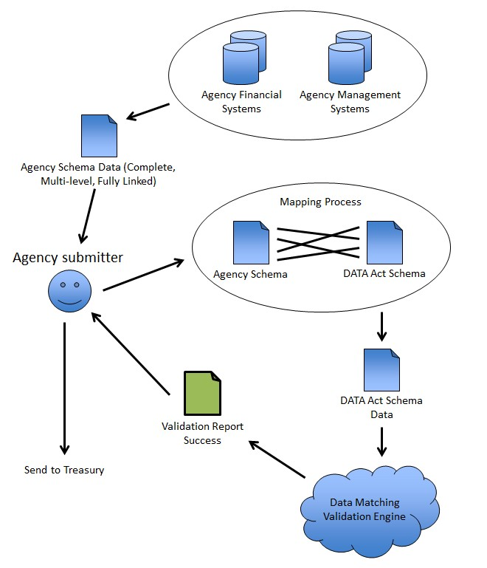

Data Broker
Broker:
Exists inside Agency’s firewall;
Maps Agency Schema to the DATA Act Schema
Validates the data in the DATA Act Schema
Provides validation report for further processing by the Agency
If validation is successful, data is ready for Agency submission to Treasury
Resources: Broker developer documentation and test plan is planned and will be available at a
later time.
13

