Slide 1


Upcoming
Changes for the Central Accounting Reporting System (CARS)

Slide 2
Agenda
Timeline & CARS Reporters Status
New Modules
Enrollment
Account Statement Functionality Changes
CARS Reporting
Upcoming Training
Help
Questions

Slide 3
Timeline
CARS System of Record (SoR) cutover weekend
CARS becomes Treasury’s official system of record
  No longer not able to view the details of the last calendar day’s transactions
  Can pull those details anytime after CARS becomes the SoR and forward
  Those details now become official data, whereas when STAR was SoR only the Summary (TAS/BETC level) data was official
CARS Availability

Slide 4
CARS Conversion Dashboard

Slide 5
New Modules
Agency Standard Reports (ASR) provides the ability for agencies to pull reports for accounts that they use.
Statement of Difference (SOD) will replace the GOALS II/IAS Statement of Difference (SOD) system, Treasury’s legacy reporting system and is used to compare ALC accountability information reported by agencies with ALC transaction information reported via Source Systems.
Check Issue Audit (CIA) allows Federal Program Agencies (FPAs) to view their Agency Location Codes (ALCs) for the purpose of identifying out of balance conditions between agency and source system reporting. This information will no longer be emailed or mailed to users.

Slide 6
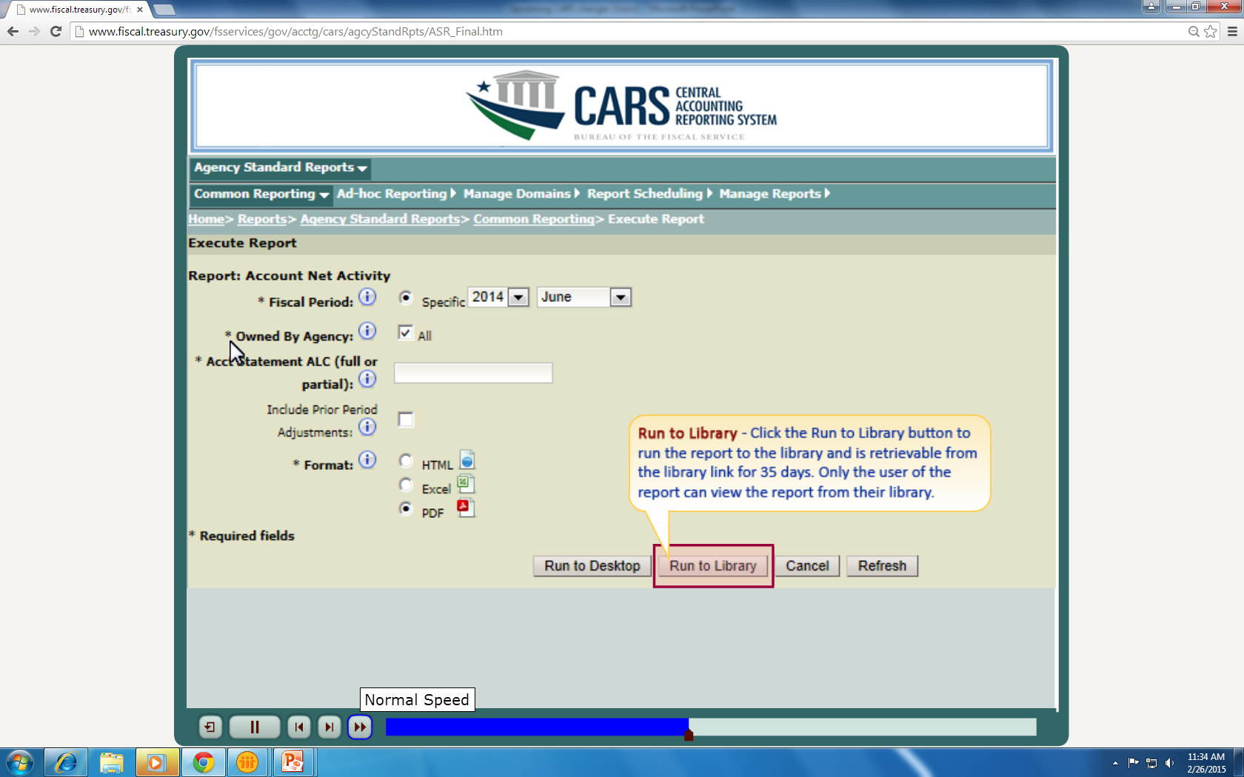

Slide 7
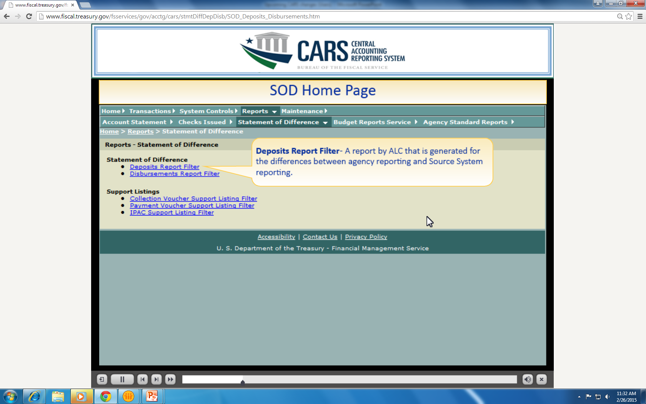

Slide 8
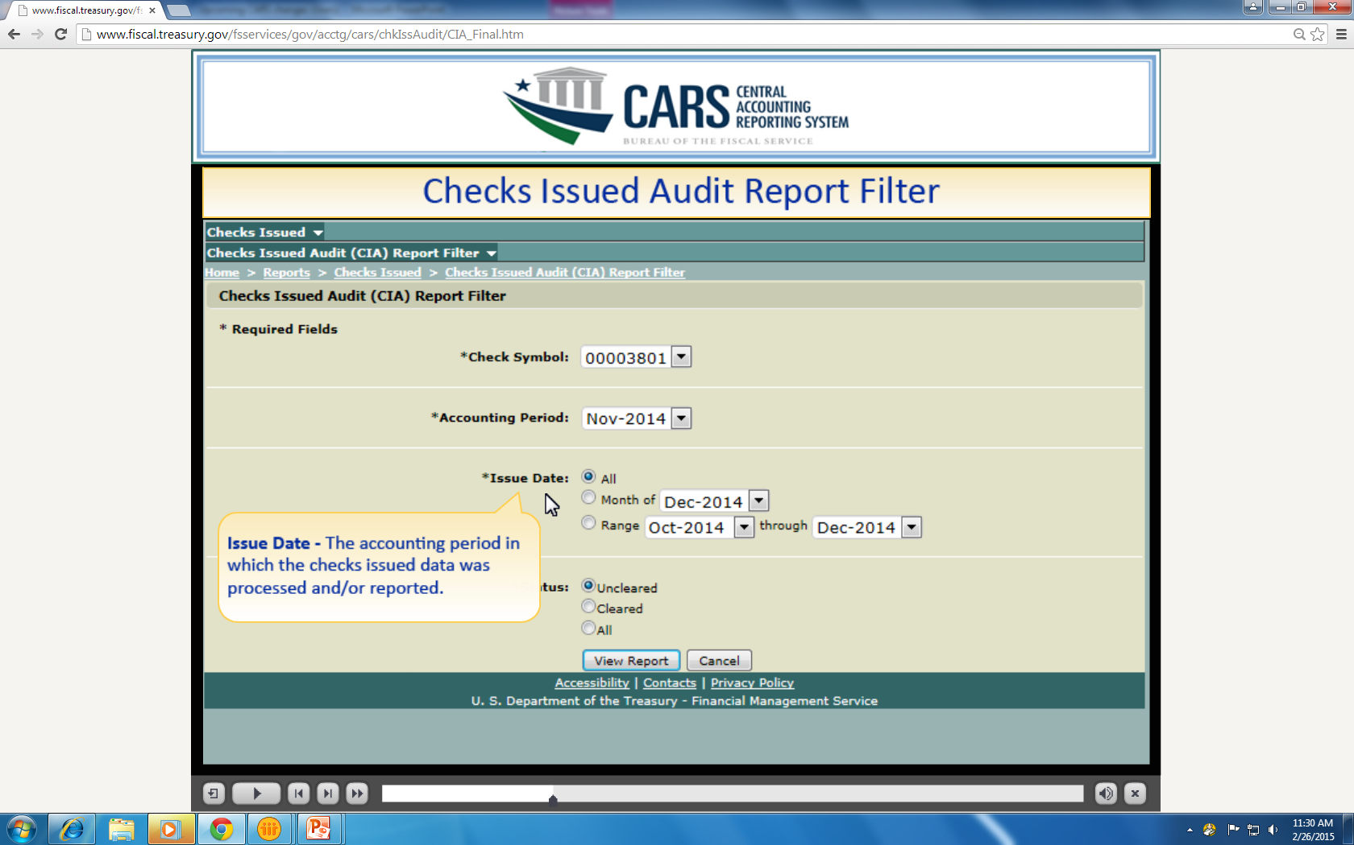

Slide 9
Enrollment
In order to access the new modules, users from eligible agencies must have:
access to the CARS application; and
the module role added to their CARS user account
***Please note that access to the new modules will not be automatically granted to existing CARS users.
https://www.fiscal.treasury.gov/cars/getting-started.html

Slide 10
Account Statement Functionality Changes
Provisional view becomes Accounting view
Accounting view and Published view remain to facilitate FBWT reconciliation
  Enhanced Functionality in the Account Statement
  Ability to download reports (including last day details)
  Reclassify in subsequent months (at the transaction level)

Slide 11
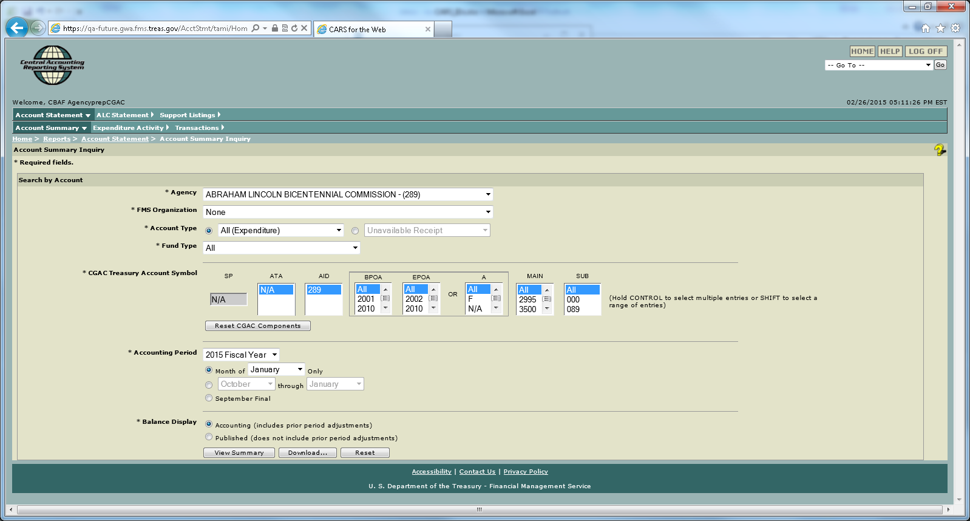
New Account/ALC Statement View

Slide 12
CARS Reporting
Transaction level detail will be available in the accounting view going forward, including the month of the cutover from our legacy system
CARS reporter transitioning continues May 2015 and beyond for ALL remaining ALCs
Scorecarding procedures remain unchanged at this time for reclassification

Slide 13

Training
E-learn documents will be posted to website (including screen shots)
  https://fiscal.treasury.gov/training/cars-webinar-and-demo-whats-new.html
  Drop in sessions March 2, March 9 and March 10
Additional Drop in sessions in April
GWA is working on detailed training for
  TAS/BETC
  Reclassification
  System Defaults

Slide 14
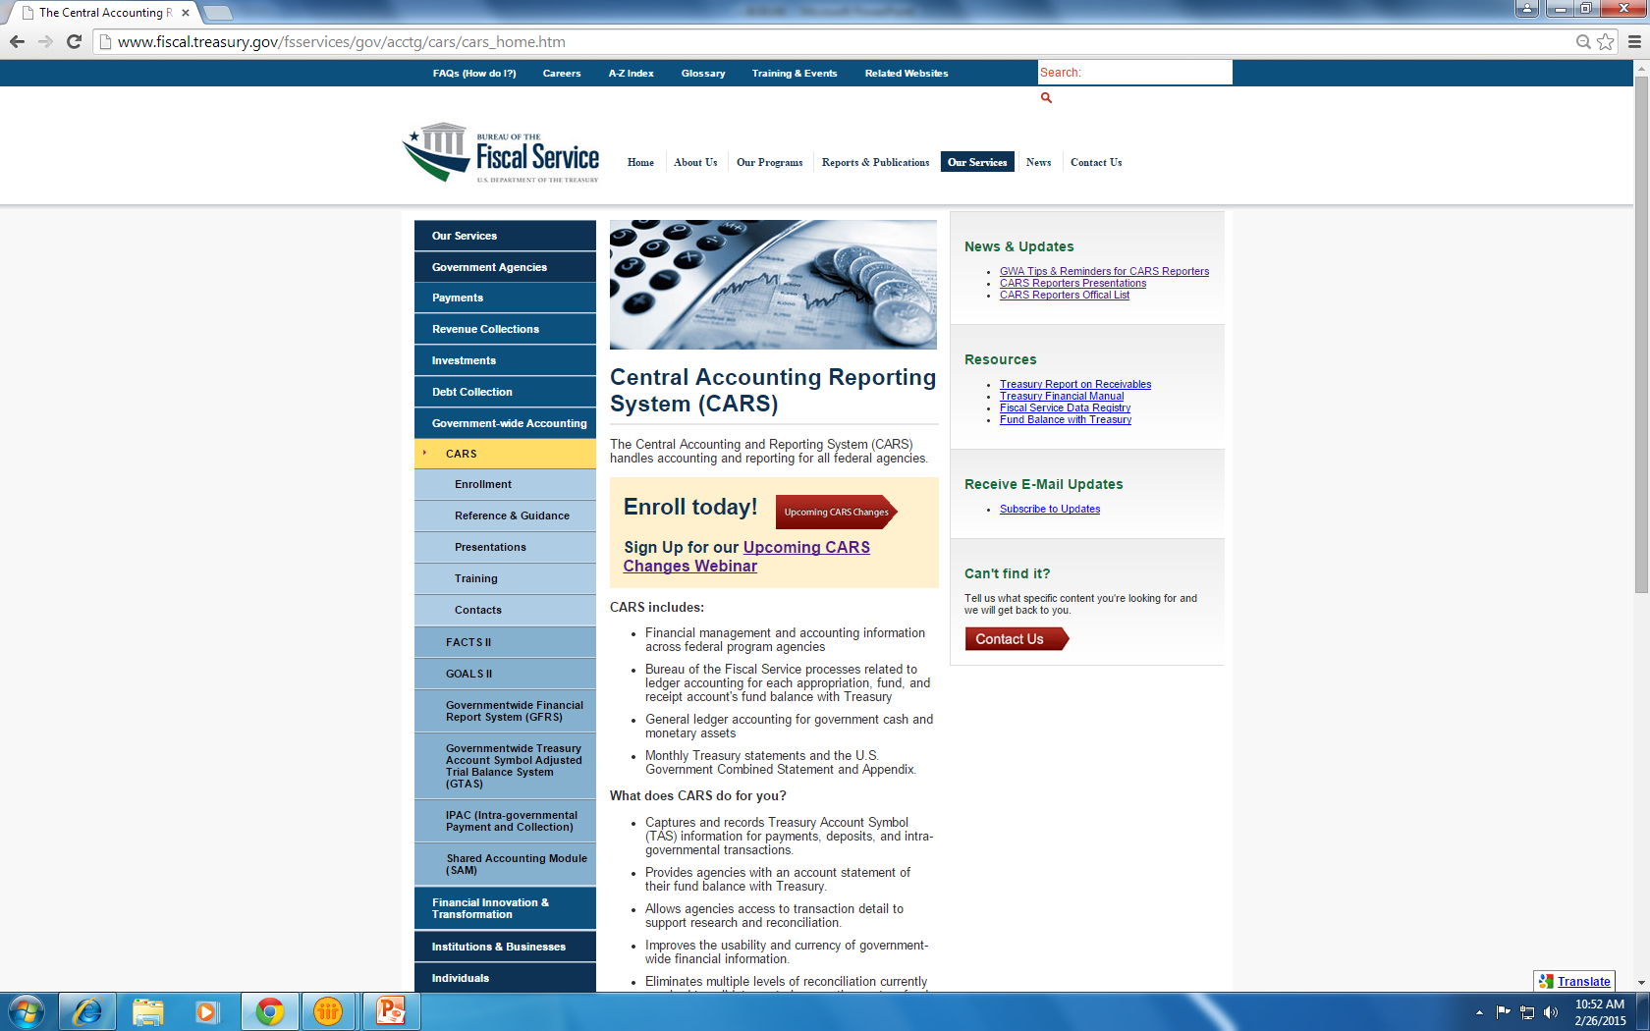

Slide 15
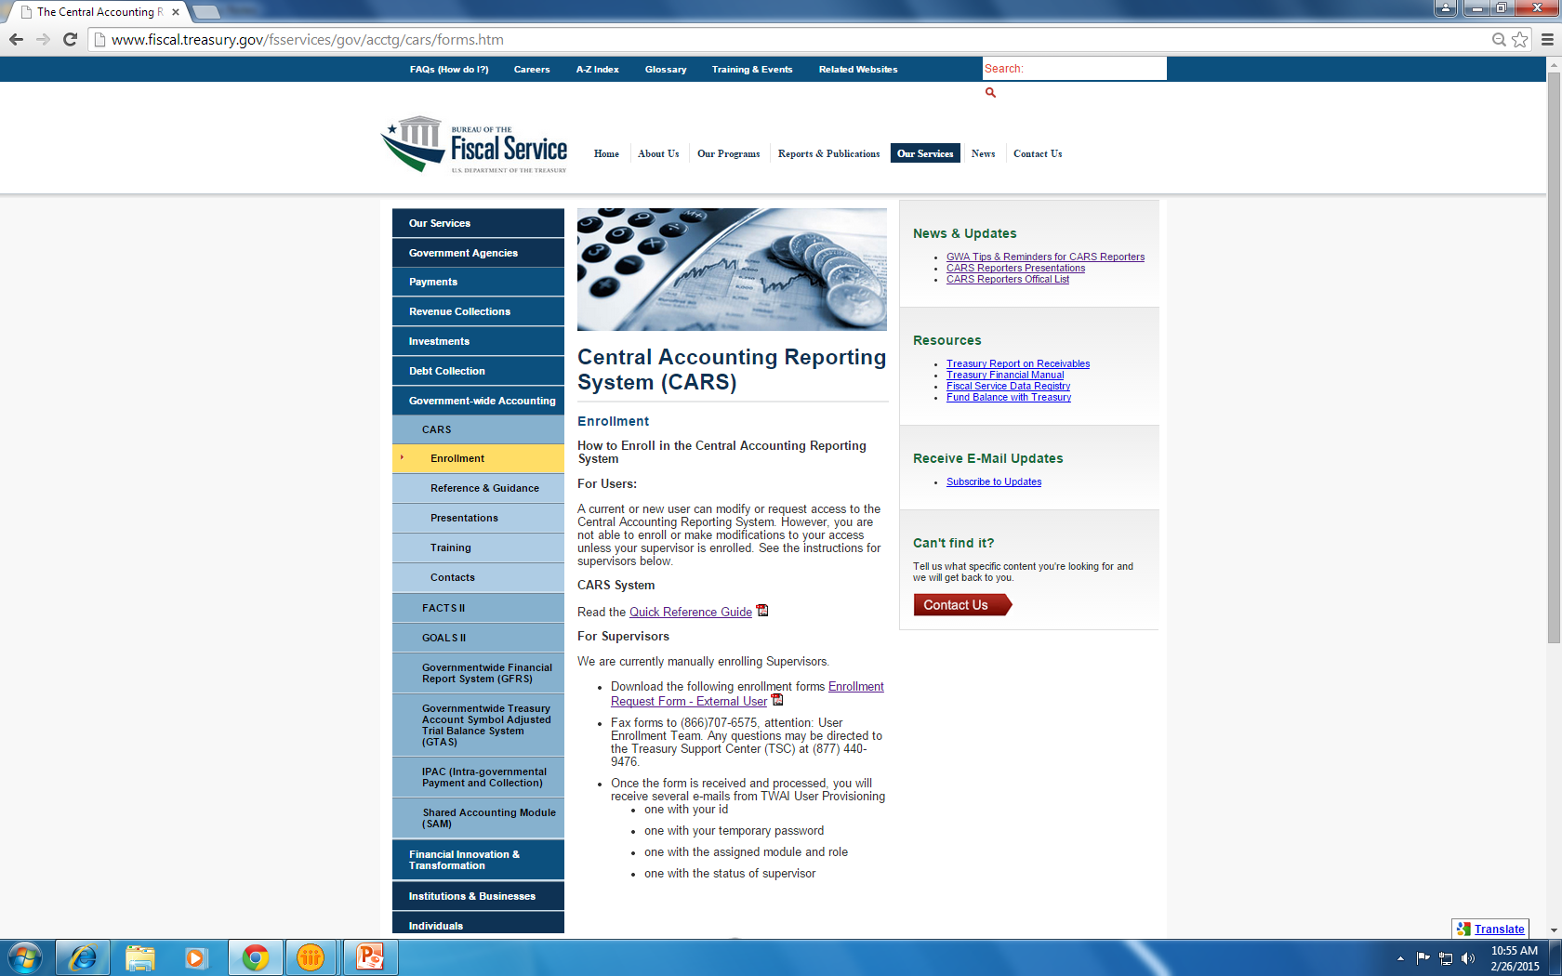

Slide 16

Help
Contact Treasury Support Center
  Phone: (877) 440-9476
  Email: gwa@stls.frb.org

Slide 17

Questions
Treasury Support Center (877) 440-9476
Customer Relationship Management
gwa.crmd.users@fiscal.treasury.gov
Director - Carolann Marker
Carolann.Marker@fiscal.treasury.gov

