Slide 1
GTAS 2.5
2.5 Release
April 2, 2015

Slide 2
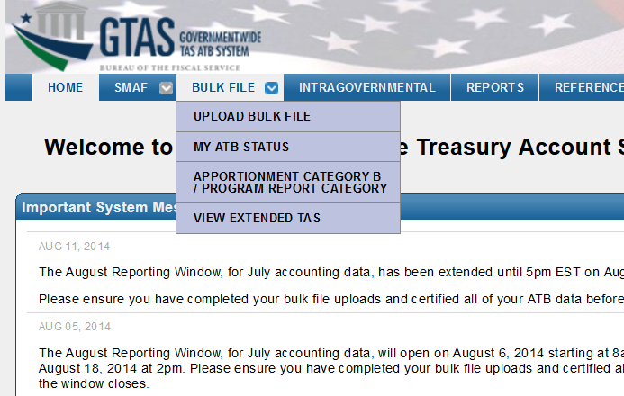
Bulk File Upload
Preparer logs in and navigates to Bulk File > Upload Bulk File
Updated Logo
New menu option to View Extended TAS

Slide 3
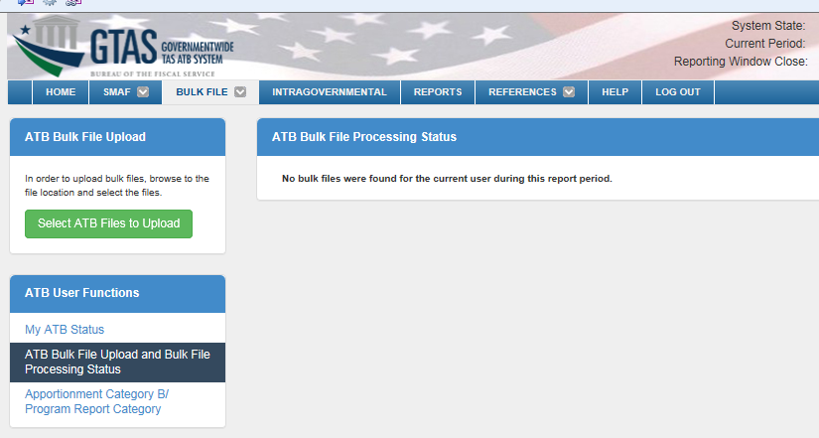
Bulk File Upload cont.
The Bulk File Upload screen has a new look and feel.

Slide 4
Bulk File Upload cont.
Click the ‘Select ATB Files to Upload’ button.

Slide 5
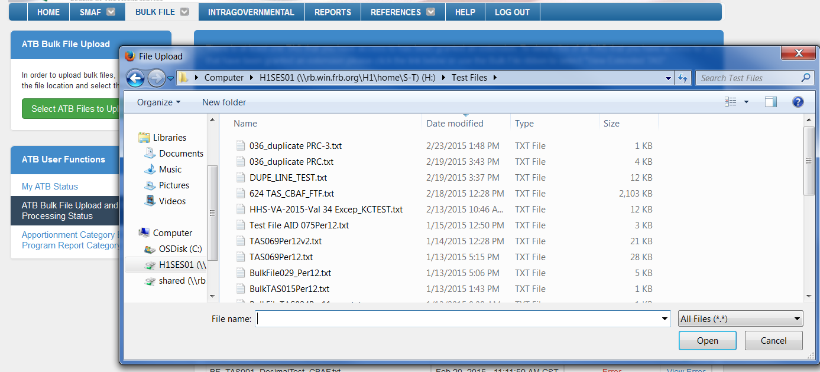
Bulk File Upload cont.
Navigate to the location of the bulk file; select the file and click the ‘Open’ button.

Slide 6
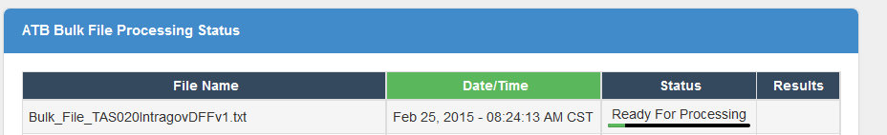
Bulk File Upload cont.
The file will display in the ATB Bulk File Processing Status.
The ATB Bulk File Processing Status’s include:
Ready for Processing
Processing File Validations
Waiting for TAS Lock
TAS Exception
Processing Validations
Processing Statements
Processing Edits
Processing Material Differences
Error
Complete

Slide 7
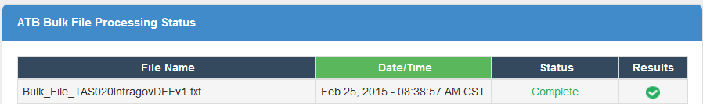
Bulk File Upload cont.
The file will display with a status of Complete after file processing has finished.

Slide 8
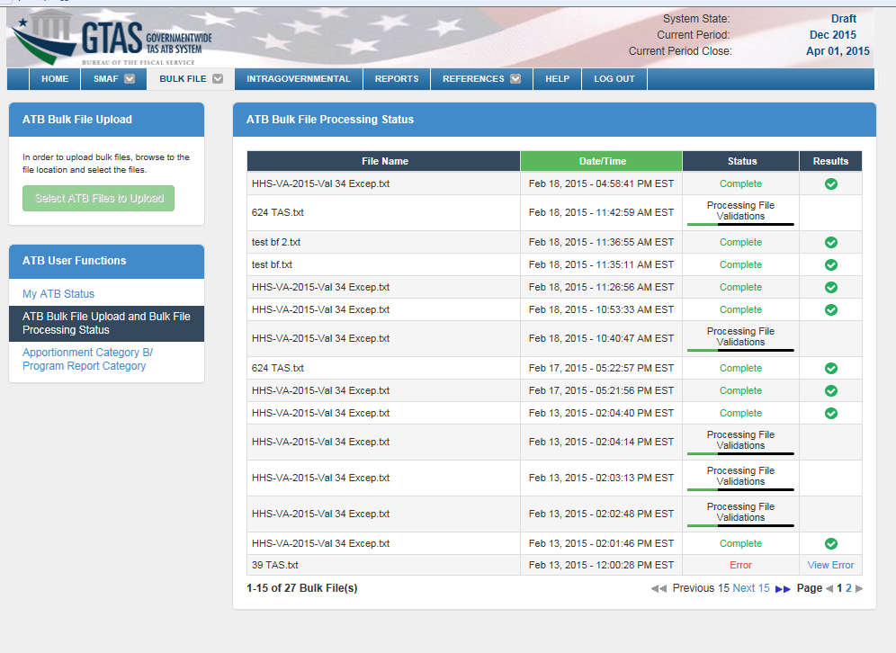
Bulk File Upload cont.
There is now an ‘ATB Bulk File Processing Status’ dashboard that displays bulk file upload history and processing status.

Slide 9
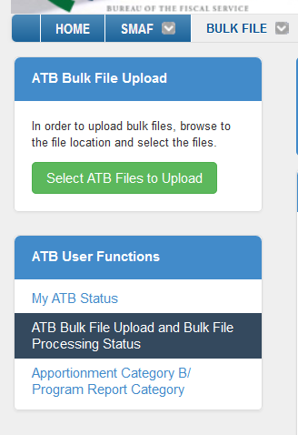
Bulk File Upload cont.
Navigate to ‘My ATB’ Status to view the TAS Submission Status
OR

Slide 10
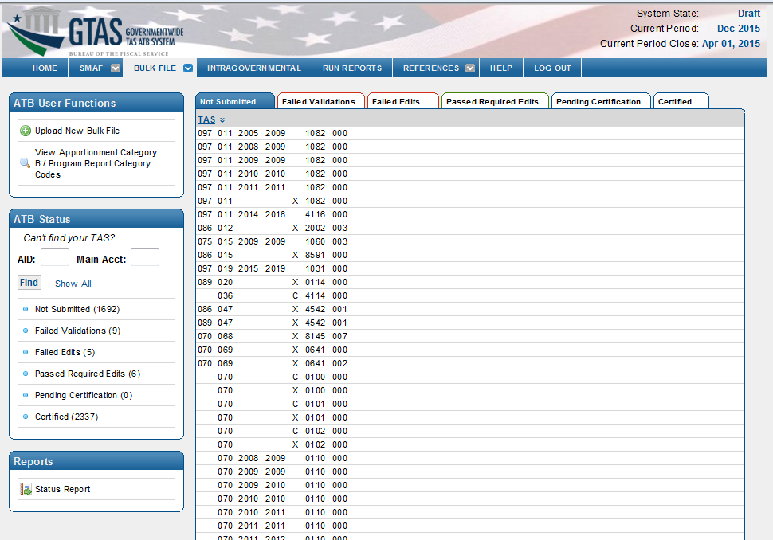
Bulk File Upload cont.
The TAS Submission Status display and Certification process is unchanged.

Slide 11
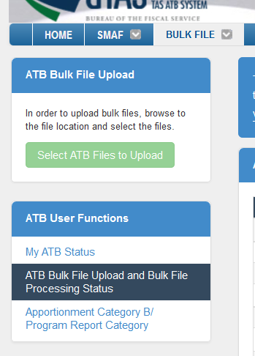
Bulk File Upload cont.
The ‘Select ATB Files to Upload’ button displays but is disabled when the reporting window is closed.

Slide 12
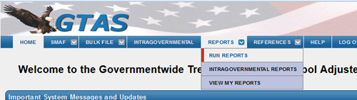
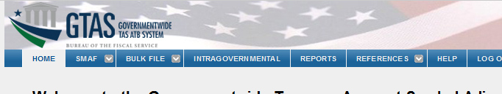
Reports Page
The Reports Menu Before
The Reports Menu After

Slide 13
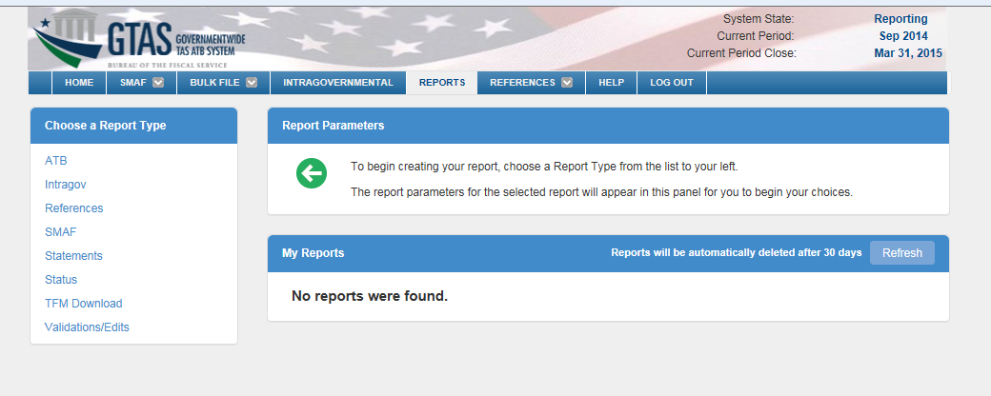
Reports Page cont.
Click the ‘Run Reports’ from the menu bar
The ‘Run and View Reports’ screens have been combined.
First, select the Report Type: ATB, Intragov, References, etc.

Slide 14
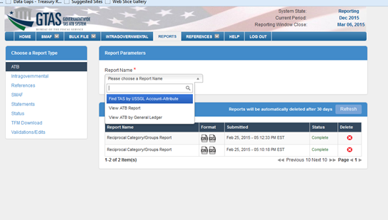
Reports Page cont.
Select the name of the report from the ‘Report Name’ drop-down.

Slide 15
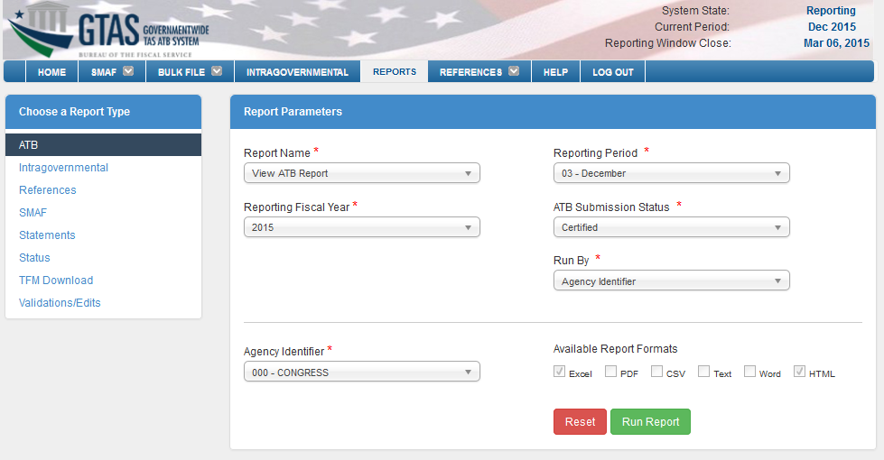
Reports Page cont.
Enter the remaining report parameters, and click ‘Run Report’

Slide 16
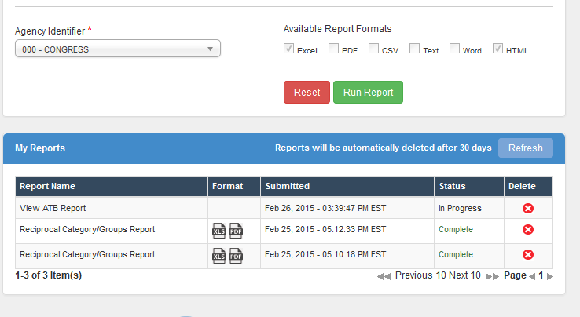
Reports Page cont.
The report is added to the ‘My Reports’ dashboard.
Click the ’Refresh’ button to update the processing status.
Reports may be opened by clicking the icons in the ‘Format’ column.
Delete the report from the dashboard by clicking the delete icon.

Slide 17
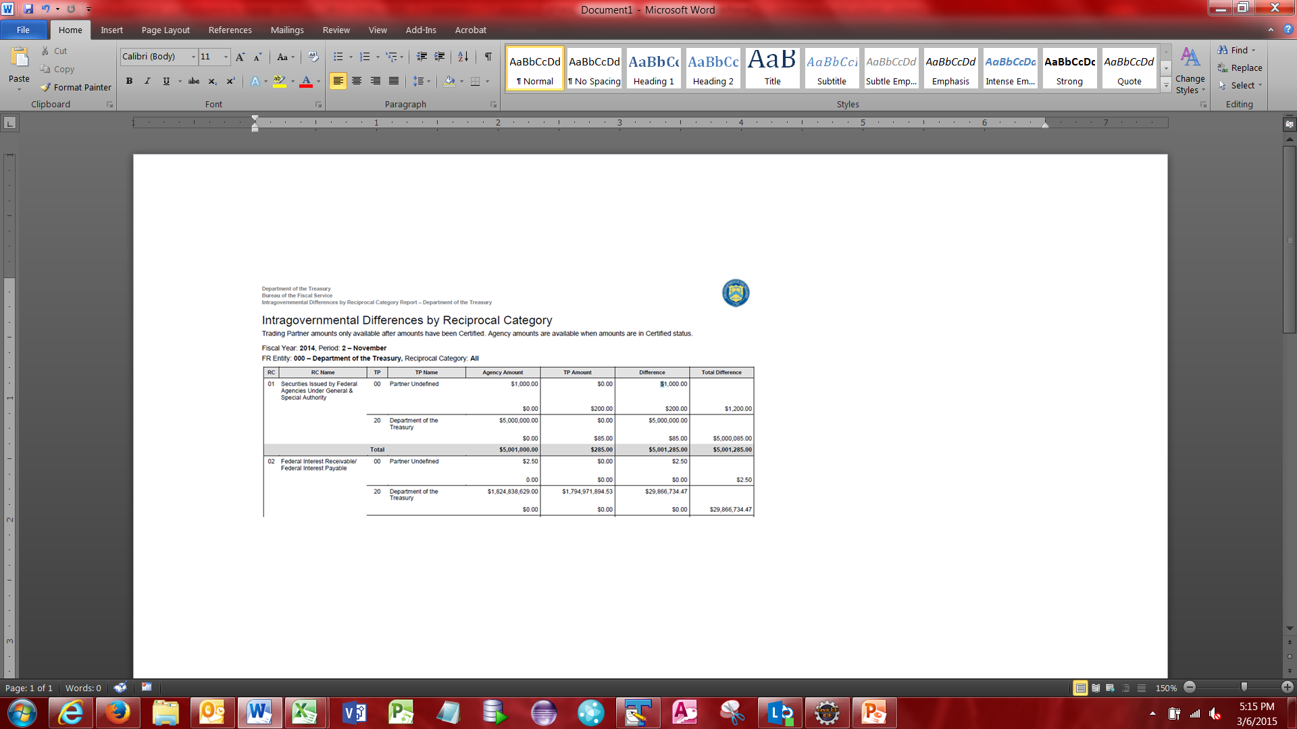
Reports - IGT Difference By RC

Slide 18
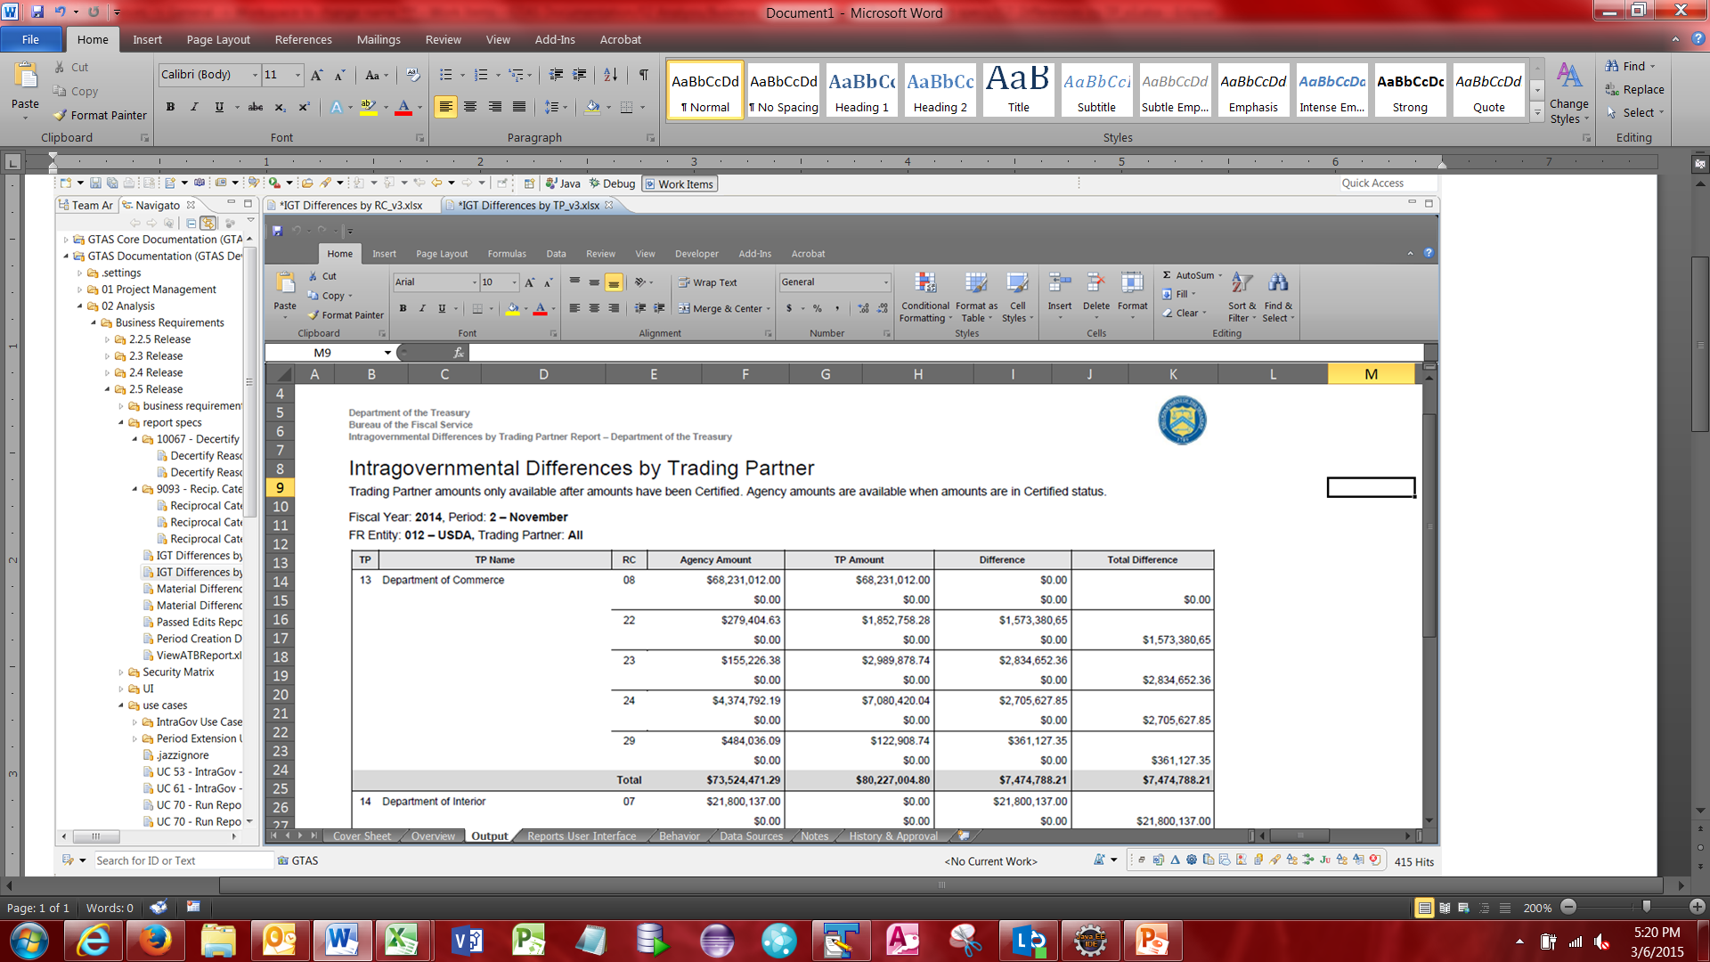
Reports - IGT Difference by TP

Slide 19
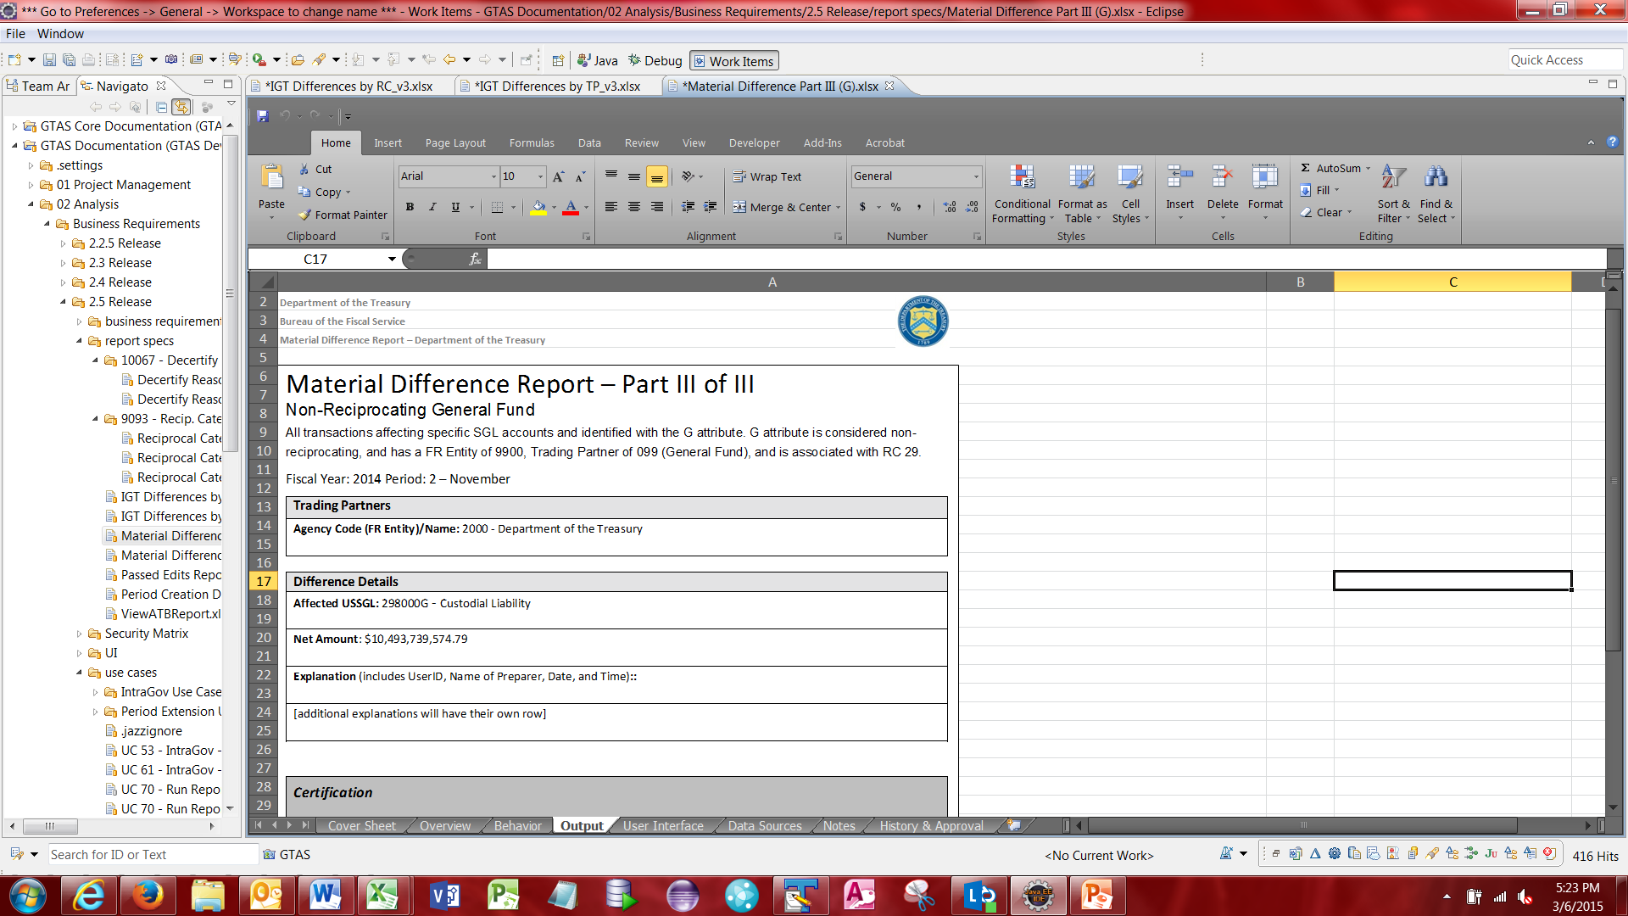
Reports - Material Difference Part III (G)

Slide 20
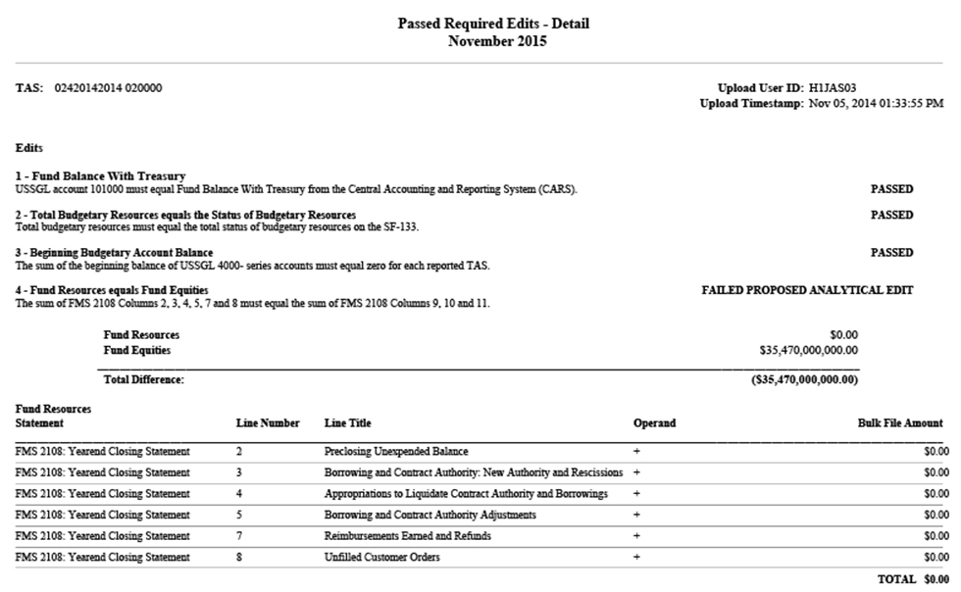
Reports - Passed Edits

Slide 21
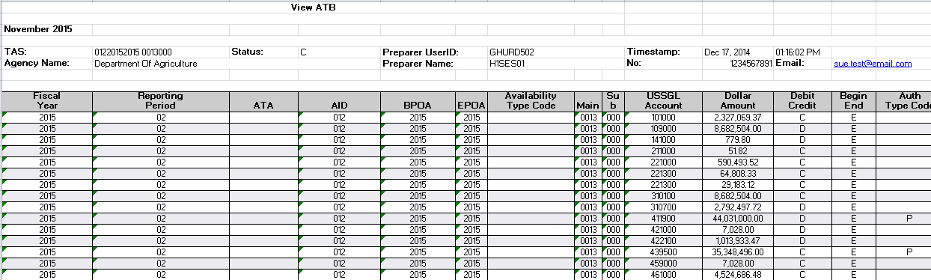
Reports - View ATB

Slide 22
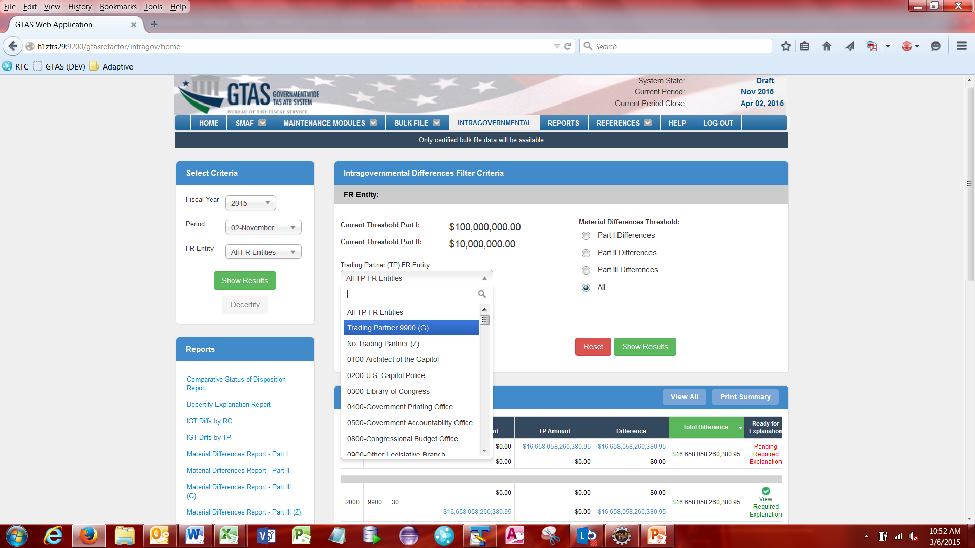
Intragovernmental G Types
The Intragovernmental Difference Filter Criteria has been updated to accommodate filtering for G types.
G types can be filtered by selecting Trading Partner (TP) FR Entity and selecting the shown selection.

Slide 23
Intragovernmental G Types cont.
The Intragovernmental Reports Table has been updated to include a link to run the Material Difference Report – Part III (G)

Slide 24
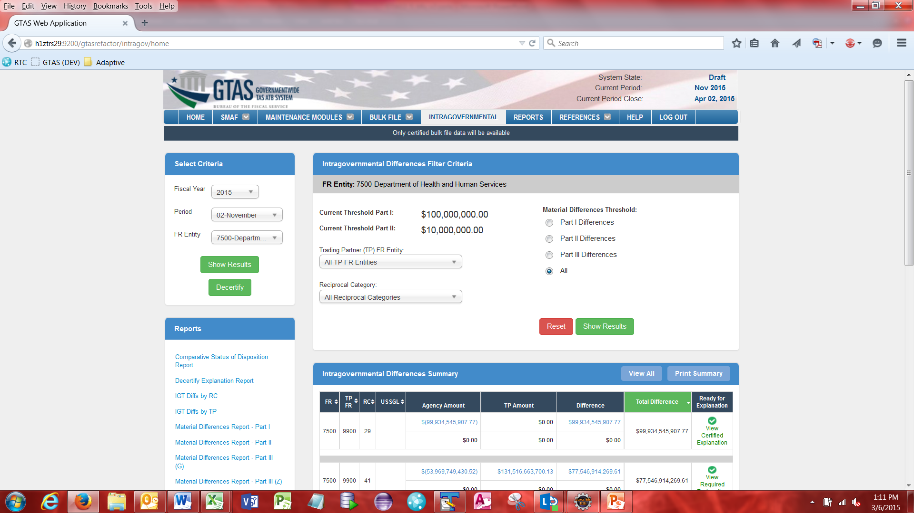
Intragovernmental Messaging
The messages that were being displayed on the Intragov screen have been reduced. Only the reminder ribbons persist.
Example screenshot shows the reminder that is displayed when the Material Difference Window is currently open or the window is past the close date.

Slide 25
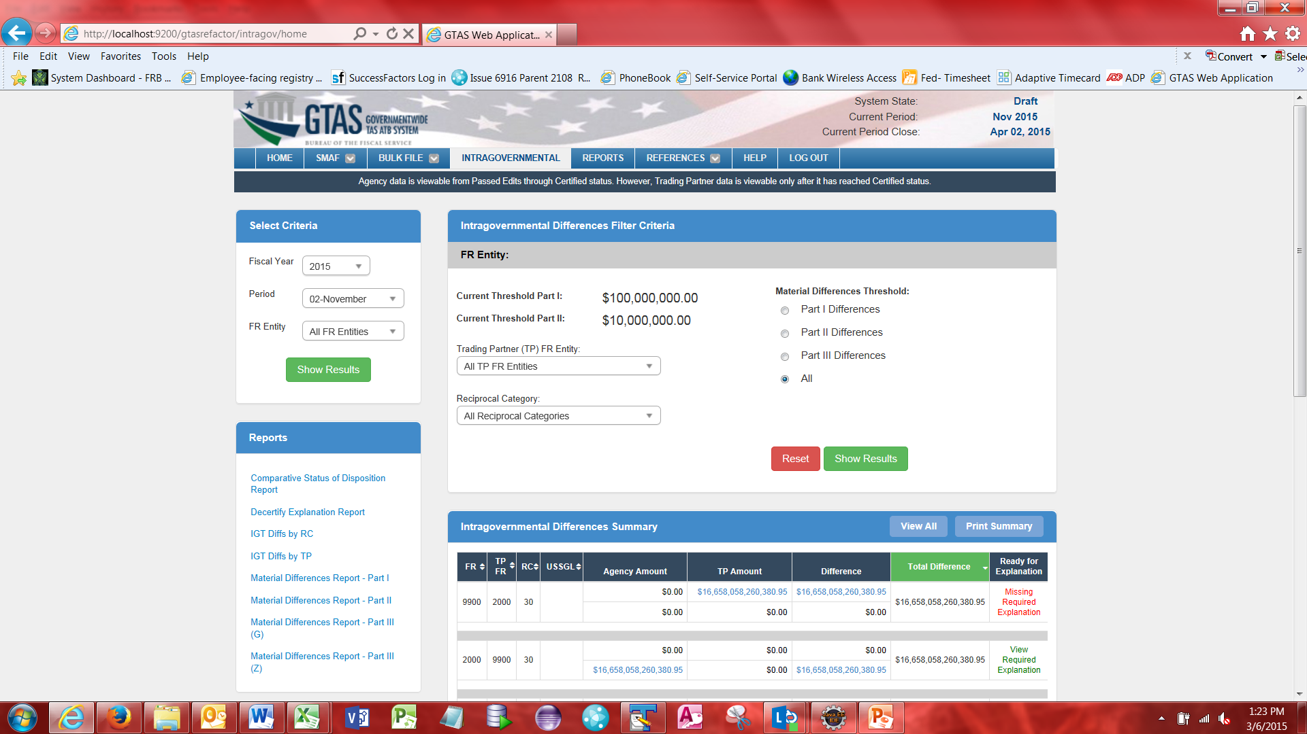
Intragovernmental Messaging cont.
Example screenshot shows the reminder that is displayed when the Material Difference Window is not yet open.

Slide 26
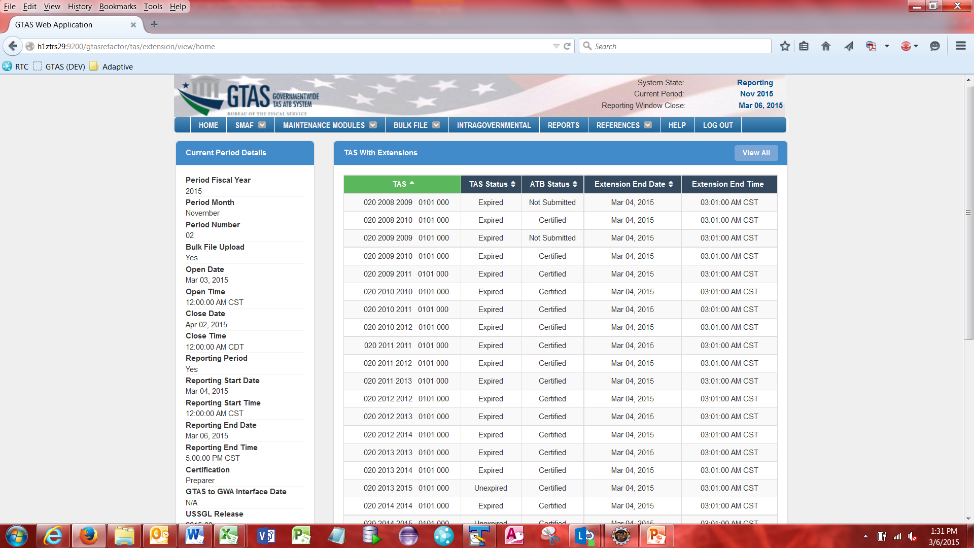
TAS Extension – View Only
Users will have the ability to see any of their assigned TAS with an extension under the Bulk File Ribbon.
Bulk File -> View Extended TAS
All user roles have access to this page.
This page is a view only page and no edits can be made using this page.

Slide 27
Questions? gtas.team@fiscal.treasury.gov

