Slide 1
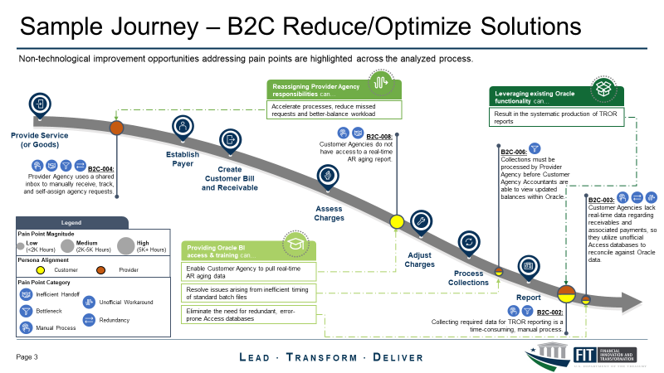
Transformation Blueprint Job Aid
The DEEE transformation blueprint template is intended to help visualize and communicate pain points and solutions across a process.
Phases of the Journey
Indicates beginning of each major phase of the analyzed process
Pain Points
The pain points and level of magnitude (based on size of bubble) are shown along the journey aligned to phase
Pain Point Magnitude
Description of the three ranges of pain point magnitude (in this example, hours spent)
Persona Alignment
Color coding for whether pain points apply for the customer, provider, or both (but can be used for other stakeholder breakouts)
Pain Point Category
Common categories related to the nature of challenge for each pain point
Solution Types
Groups of common solutions to resolve one or more pain points with descriptions

Slide 2
Sample – B2C Current State Pain Points
Prioritized pain points are illustrated throughout the analyzed process in their current state including magnitude, persona alignment, and pain point category information.
B2C-001:
Customer Agency creates Excel request template for all AR tasks.
Provide Service (or Goods)
B2C-008:
Customer Agencies do not have access to a real-time AR aging report.
Establish Payer
B2C-006:
Collections must be processed by Provider Agency before Customer Agency Accountants are able to view updated balances within Oracle.
B2C-004:
Provider Agency uses a shared inbox to manually receive, track, and self-assign agency requests.
Create Customer Bill and Receivable
B2C-005:
Provider Agency personnel manually notify some Customer Agencies of completed requests via email.
B2C-003:
Customer Agencies lack real-time data regarding receivables and associated payments, so they utilize unofficial Access databases to reconcile against Oracle data.
Assess Charges
Legend
B2C-009:
Provider Agency often must reach out to Customer Agencies to request information not included in the Collections Information Repository (CIR) Report.
Pain Point Magnitude
Low
(<2K Hours)
Medium
(2K-5K Hours)
High
(5K+ Hours)
Persona Alignment
Adjust Charges
Customer
Provider
Process Collections
Pain Point Category
Inefficient Handoff
Report
Unofficial Workaround
B2C-002:
Collecting required data for TROR reporting is a time-consuming, manual process.
Bottleneck
Redundancy
Manual Process

Slide 3
Sample – B2C Reduce/Optimize Solutions
Reduce/Optimize improvement opportunities organized into categories by solution and aligned to the pain points each addresses.
Reassigning Provider Agency
responsibilities can…
Leveraging existing Oracle functionality can…
Accelerate processes, reduce missed requests and better-balance workload
Result in the systematic production of TROR reports
Provide Service (or Goods)
B2C-008:
Customer Agencies do not have access to a real-time AR aging report.
Establish Payer
B2C-006:
Collections must be processed by Provider Agency before Customer Agency Accountants are able to view updated balances within Oracle.
B2C-004:
Provider Agency uses a shared inbox to manually receive, track, and self-assign agency requests.
Create Customer Bill and Receivable
B2C-003:
Customer Agencies lack real-time data regarding receivables and associated payments, so they utilize unofficial Access databases to reconcile against Oracle data.
Assess Charges
Legend
Pain Point Magnitude
Low
(<2K Hours)
Medium
(2K-5K Hours)
High
(5K+ Hours)
Providing Oracle BI
access & training can…
Persona Alignment
Adjust Charges
Customer
Provider
Enable Customer Agency to pull real-time AR aging data
Pain Point Category
Process Collections
Inefficient Handoff
Resolve issues arising from inefficient timing of standard batch files
Report
Unofficial Workaround
Eliminate the need for redundant, error-prone Access databases
B2C-002:
Collecting required data for TROR reporting is a time-consuming, manual process.
Bottleneck
Redundancy
Manual Process

Slide 4



Sample – B2C Digitize Solutions
Digitize improvement opportunities organized into categories by solution and aligned to the pain points each addresses. Note there may be multiple solutions to a pain point across Reduce/Optimize, Digitize, Innovate.
B2C-001:
Customer Agency creates Excel request template for all AR tasks.
A Smart Workflow can…
Automatically assign pending tasks to appropriate personnel and track progress
B2C-009:
Provider Agency often must reach out to Customer Agencies to request information not included in the Collections Information Repository (CIR) Report.
Track action / ticket status and notify customer agencies of request completion
Provide Service (or Goods)
Establish Payer
B2C-004:
Provider Agency uses a shared inbox to manually receive, track, and self-assign agency requests.
Create Customer Bill and Receivable
B2C-005:
Provider Agency personnel manually notify some Customer Agencies of completed requests via email.
Assess Charges
An Intelligent Automation
tool can…
Legend
Automatically compile and report relevant agency TROR data and produce report
Pain Point Magnitude
Low
(<2K Hours)
Medium
(2K-5K Hours)
High
(5K+ Hours)
An Electronic Data Interface* solution can…
Persona Alignment
Adjust Charges
Customer
Provider
Allow users to exchange data automatically with data validation and no manual intervention
Process Collections
Pain Point Category
Inefficient Handoff
Report
Unofficial Workaround
Eliminates the need for some ad hoc communication by automatically pulling required information into Provider Agency systems
B2C-002:
Collecting required data for TROR reporting is a time-consuming, manual process.
Bottleneck
Redundancy
Manual Process
*Scaling automation of data exchange may indirectly eliminate other pain points

Slide 5
Sample - B2C Pain Point Solutions by Category
The table below provides a consolidated view of process pain points and solutions presented throughout the Transformation Blueprint by solution category.
Improvement Recommendation | Potential Solution | Pain Points Resolved | Pain Point Magnitude / Annual Workload* |  | Solution Value | B2C Process Scalability
Reduce/Optimize Oracle BI Access and Training | Provide additional Oracle BI access, support, and training to customer agencies | B2C-008: Customer Agencies do not have access to a real-time AR aging report |  | 1,640 |  | High
 |  | B2C-006: Collections must be processed by Provider Agency before Customer Agency Accountants are able to view updated balances within Oracle. |  | 120
 |  | B2C-003: Customer Agencies lack real-time data regarding receivables and associated payments, so they utilize unofficial Access databases to reconcile against Oracle data. |  | 100
Digitize Smart Workflow Enablement | Streamline AR requests, task assignment, and task completion notifications through Enhanced Smart Workflows | B2C-001: Customer Agencies manually complete Excel based request templates for all AR tasks. |  | 6,300 |  | High
 |  | B2C-004: Provider Agency uses a shared inbox to manually receive, track, and self-assign agency requests. |  | 3,900
 |  | B2C-005: Provider Agency personnel manually notify some Customer Agencies of completed requests via email. |  | 150
Digitize Intelligent Automation | Automate TROR data compilation, AR task assignment, and task completion notifications | B2C-002: Collecting required data for TROR reporting is a time-consuming, manual process. |  | 7,100 |  | Medium
 |  | B2C-005: Provider Agency personnel manually notify some Customer Agencies of completed requests via email. |  | 150
 |  | B2C-004: Provider Agency uses a shared inbox to manually receive, track, and self-assign agency requests. |  | 3,900
Reduce/Optimize Leverage Existing Oracle Functionality | Configure specialized TROR report within Oracle to streamline data compilation and reporting | B2C-002: Collecting required data for TROR reporting is a time-consuming, manual process. |  | 7,100 |  | Medium
Digitize Electronic Data Interchange | Implement an EDI solution to eliminate error-prone templates | B2C-001: Customer Agency creates Excel request template for all AR tasks. |  | 6,300 |  | Low
1
2
3
Additional
Considerations
* Annual workload estimated based on input from Provider and Customer Agency accountants.
Solution Value
Improves CX
Enhances Controls
Increases Process Speed
Persona Alignment
Customer
Provider
Pain Point Magnitude
Low
(<2K Hours)
Medium
(2K-5K Hours)
High
(5K+ Hours)

